Slide 1
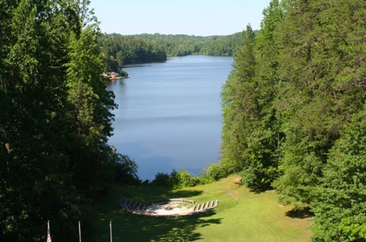
Camp Woods & Wildlife
2025

Slide 2
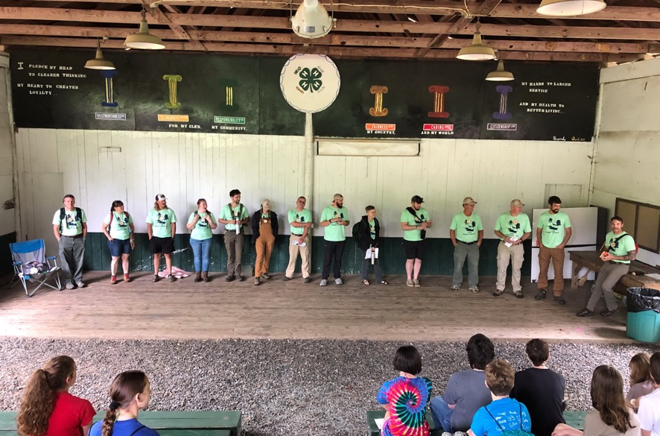
I started before you were born!

Slide 3
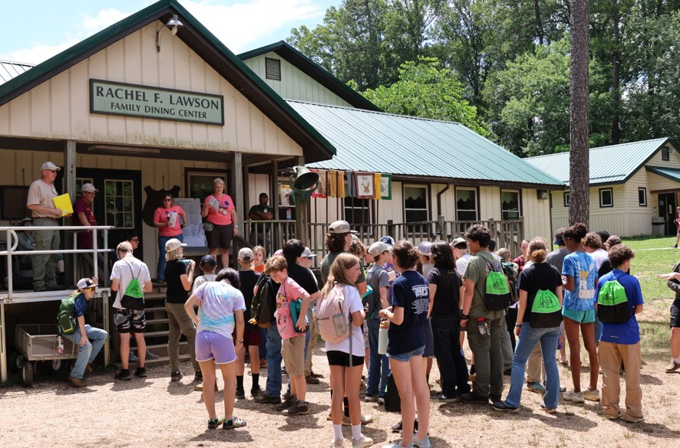

Slide 4
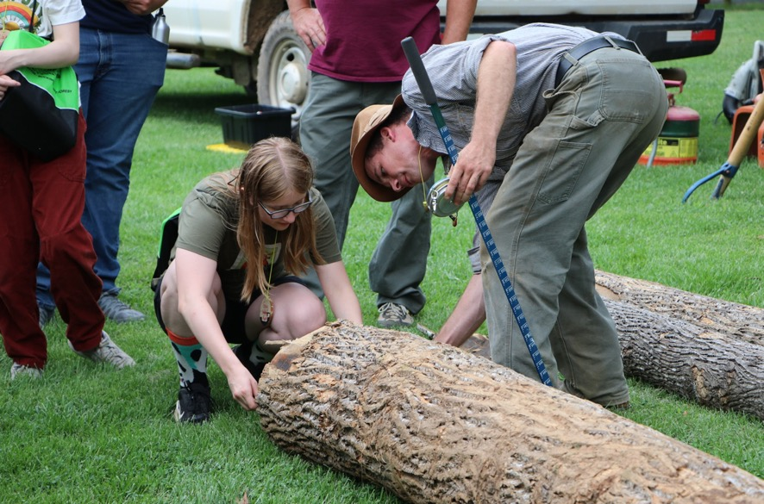

Slide 5
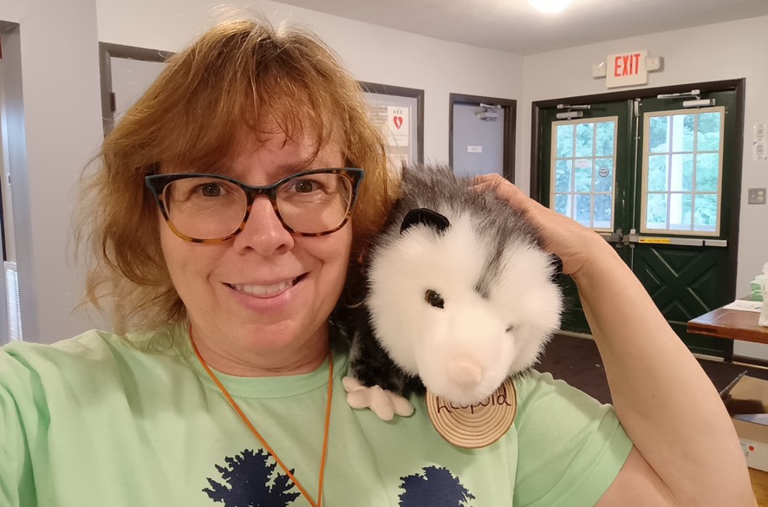
My buddy

Slide 6
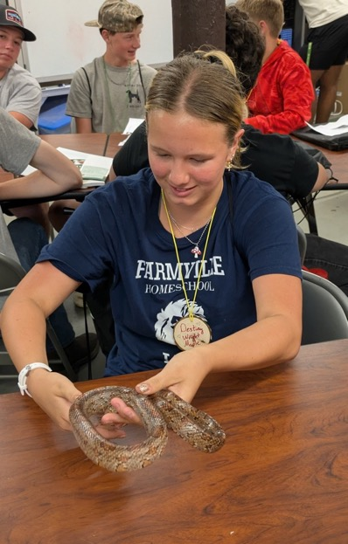

Slide 7
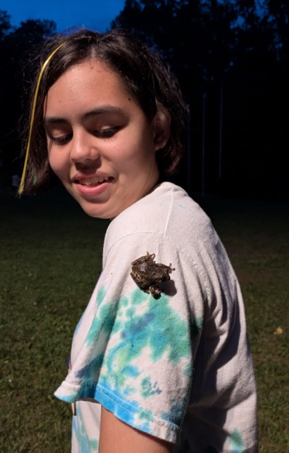
Say hello to my little friend

Slide 8
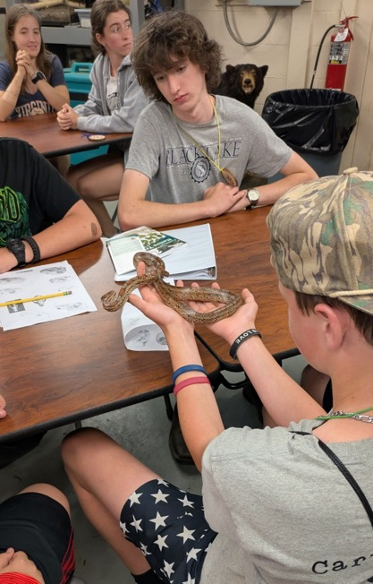
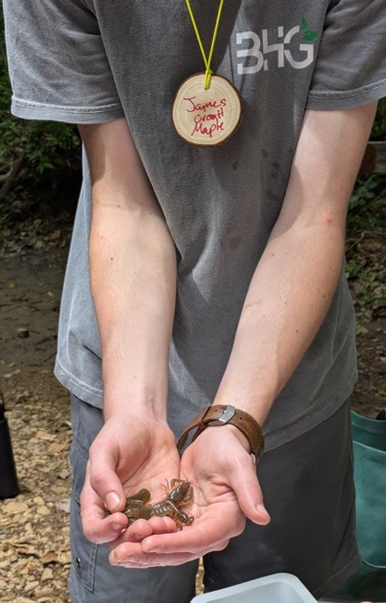

Slide 9


Slide 10
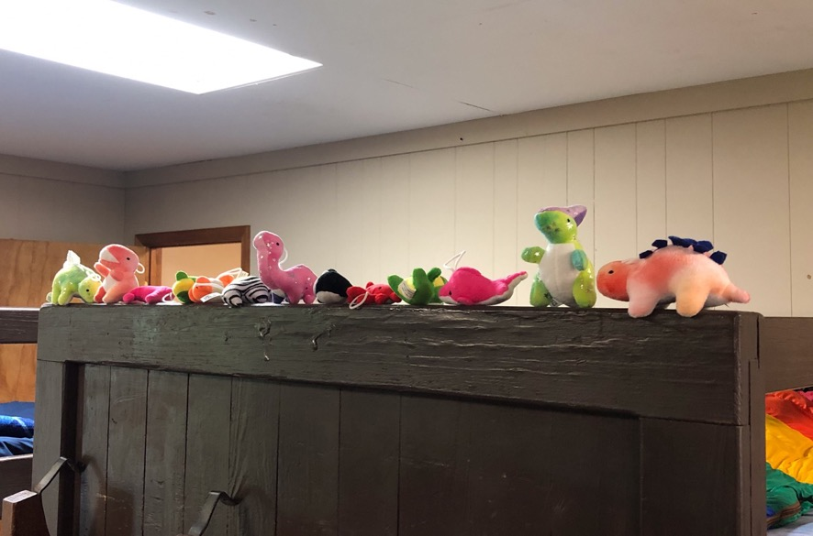
More critters

Slide 11
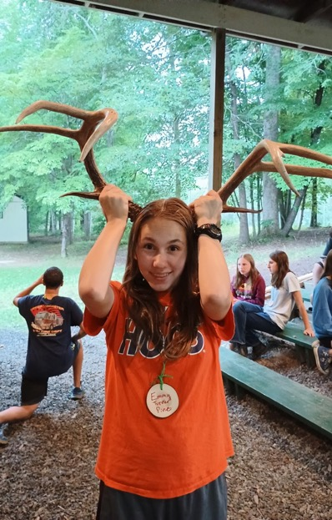
Another species?

Slide 12
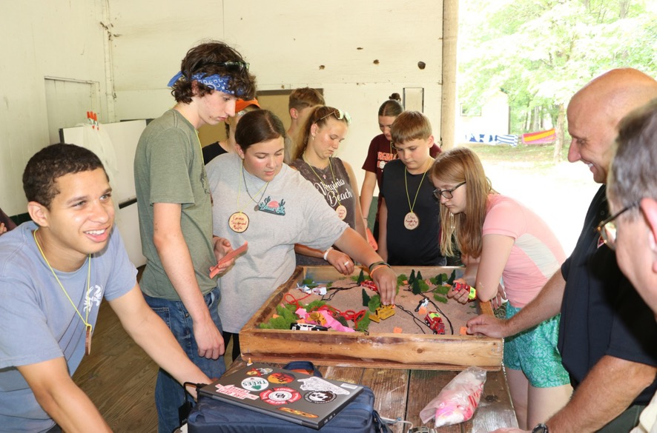

Slide 13
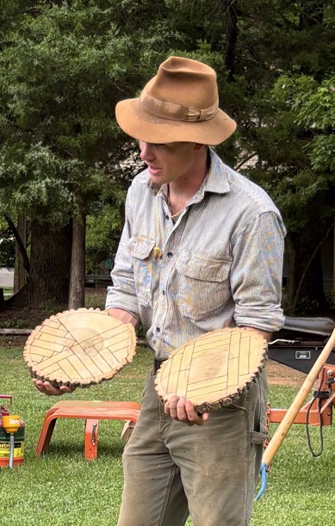
Wood Art

Slide 14
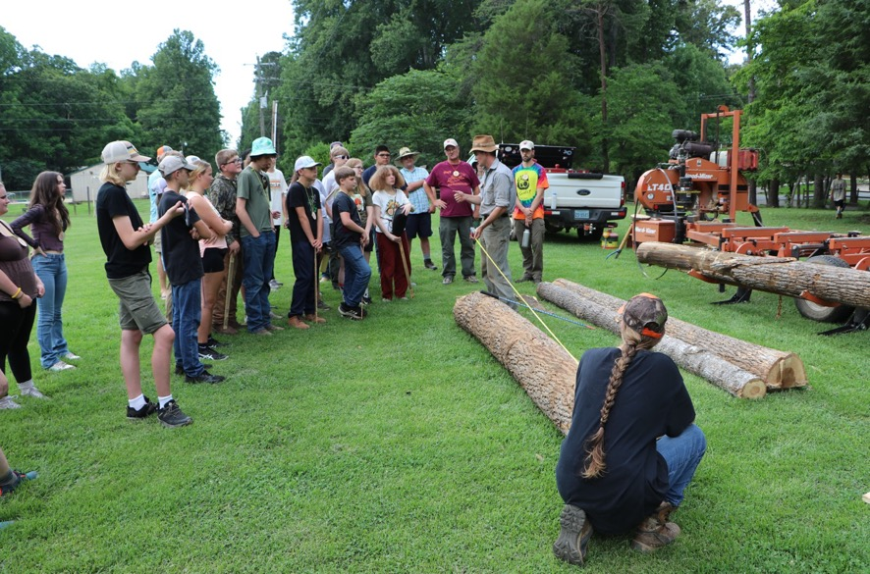

Slide 15
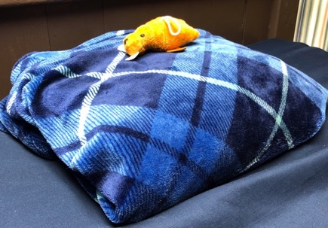
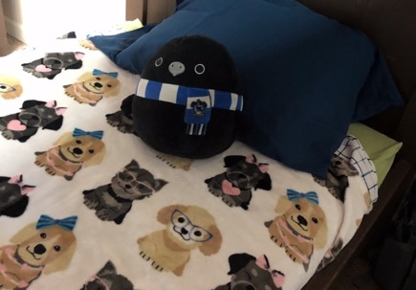
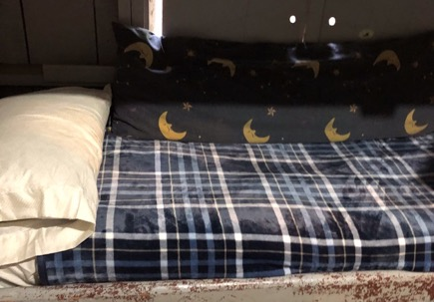
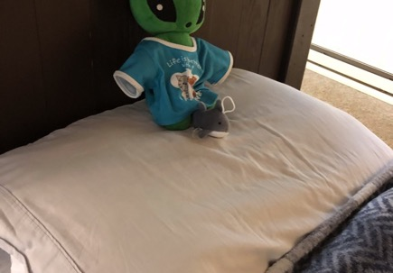
This is what neat looks like

Slide 16
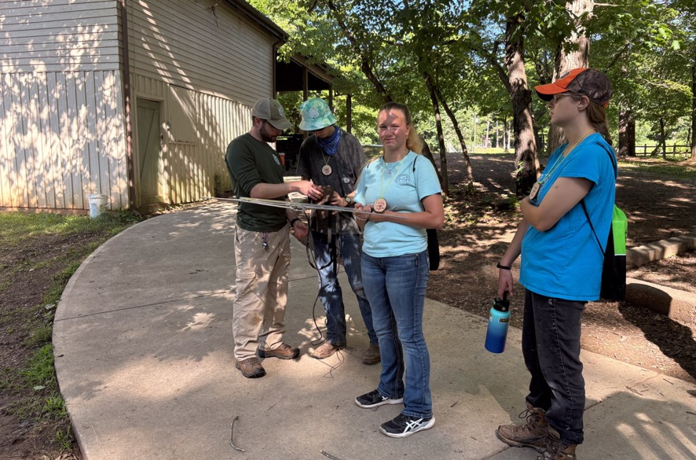

Slide 17
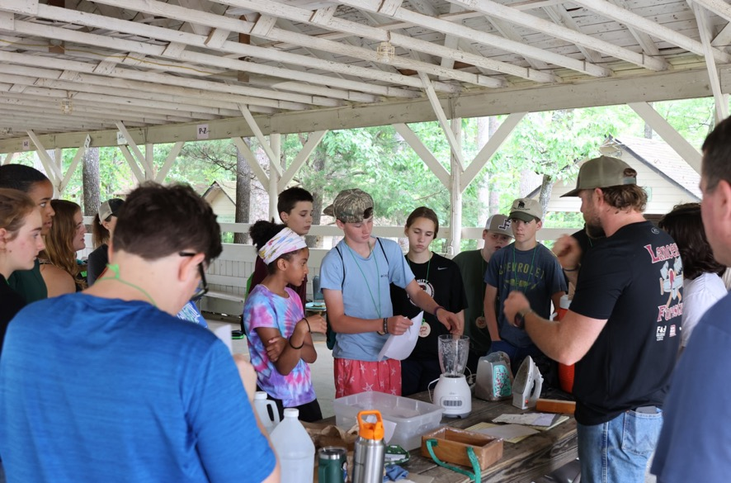
Blendin’ paper?

Slide 18
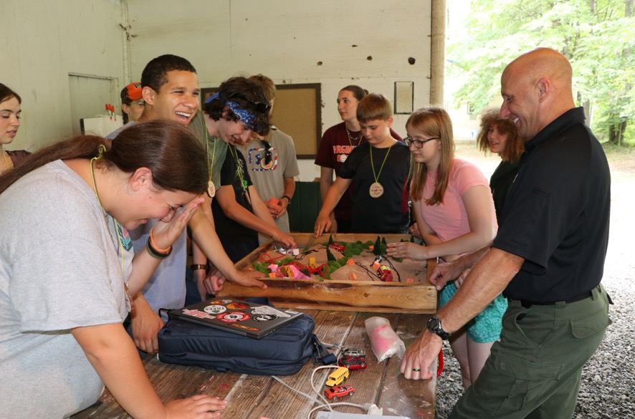

Slide 19
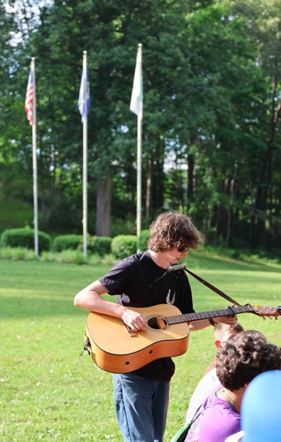

Slide 20
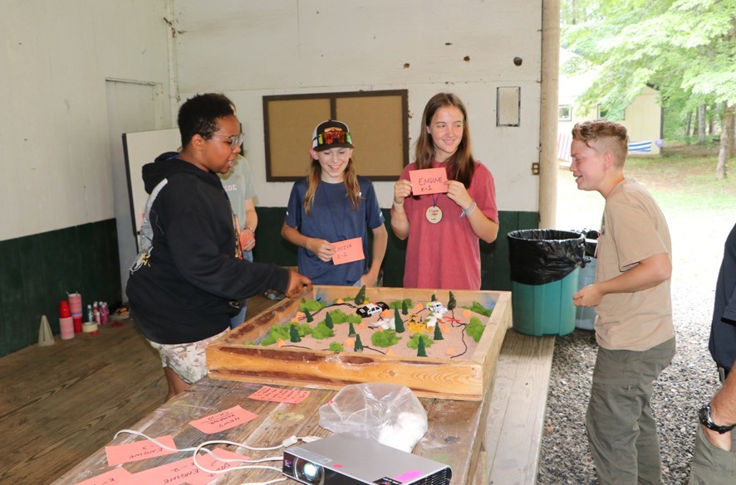

Slide 21
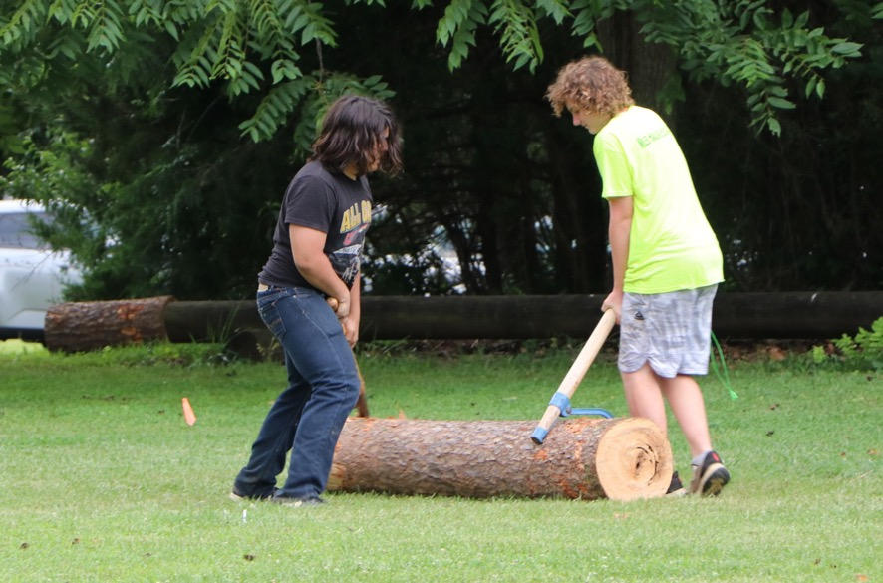

Slide 22
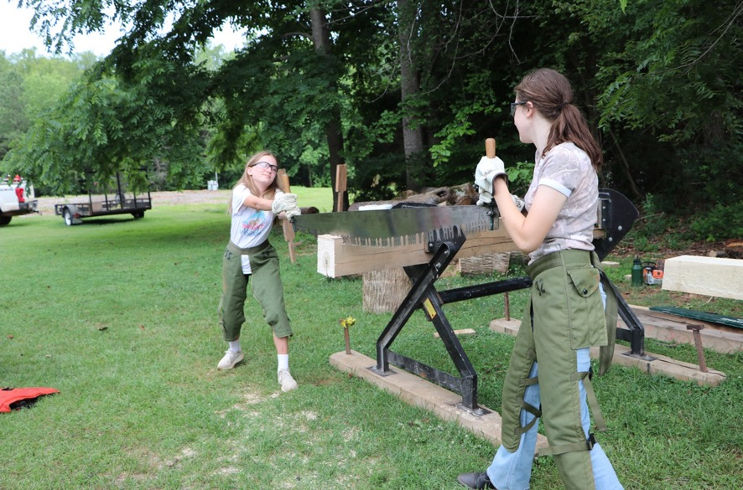

Slide 23
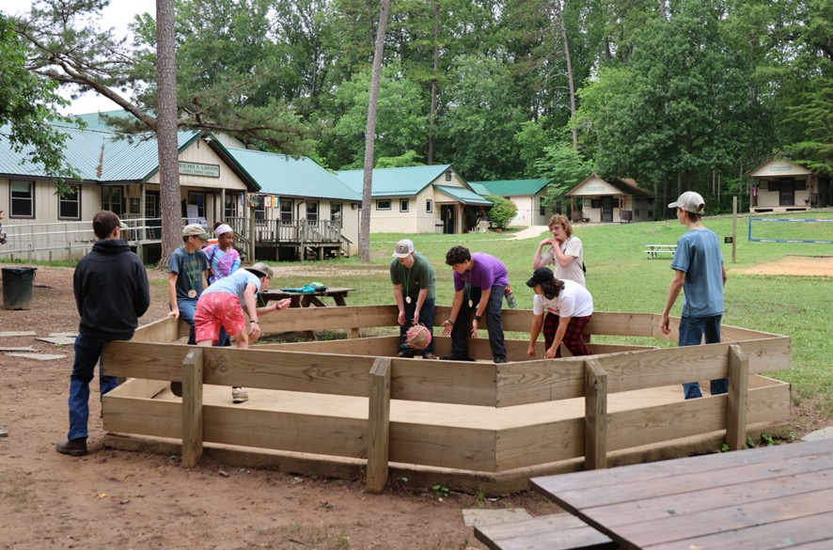

Slide 24
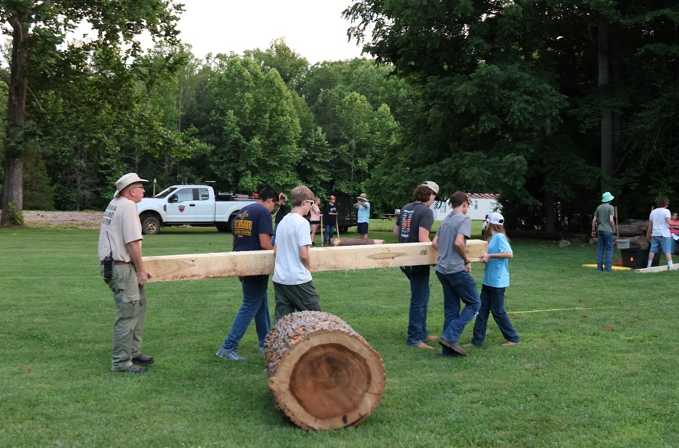

Slide 25
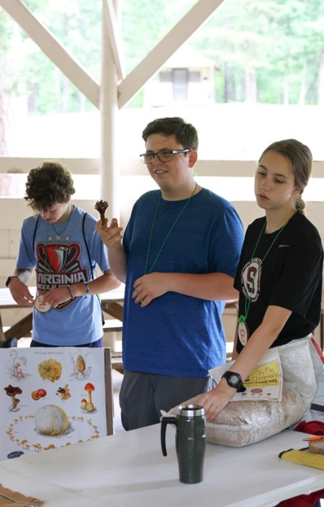

Slide 26
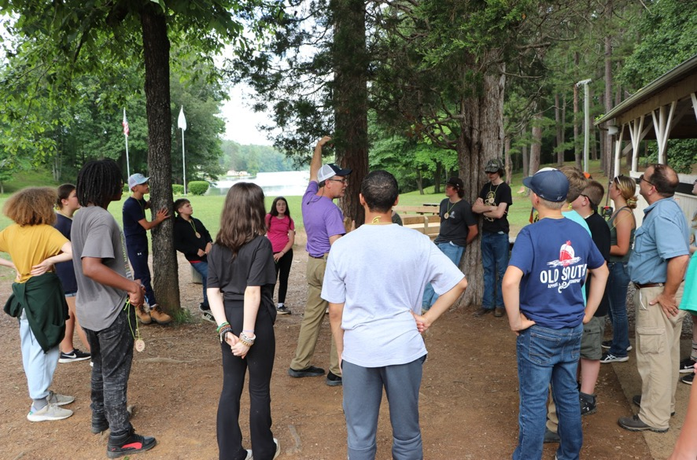

Slide 27
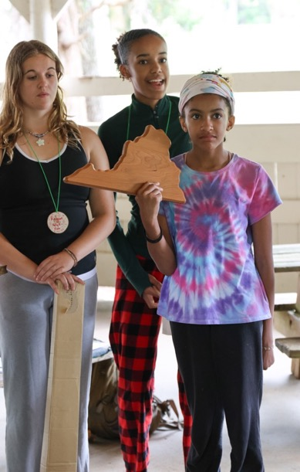

Slide 28
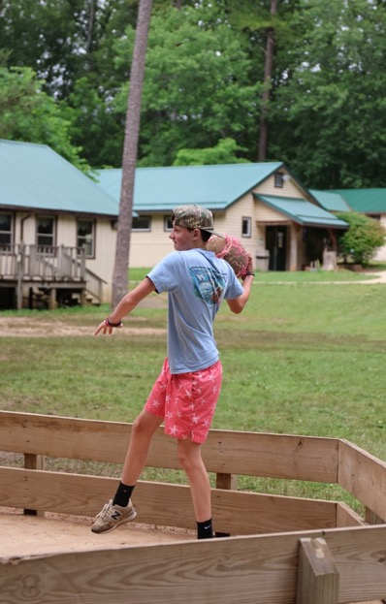

Slide 29
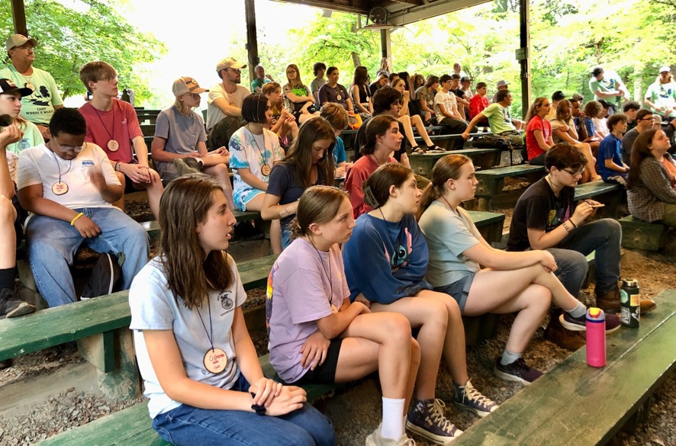

Slide 30
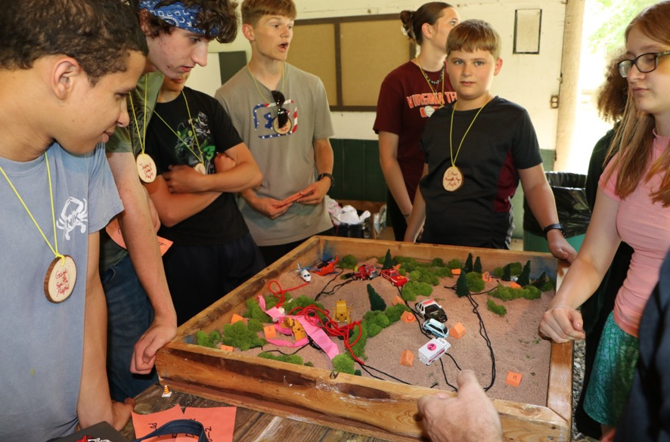

Slide 31
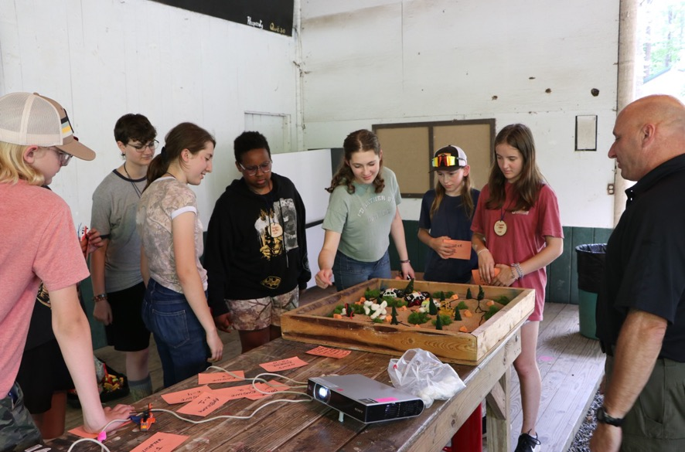
FIRE’S BURNIN’!

Slide 32
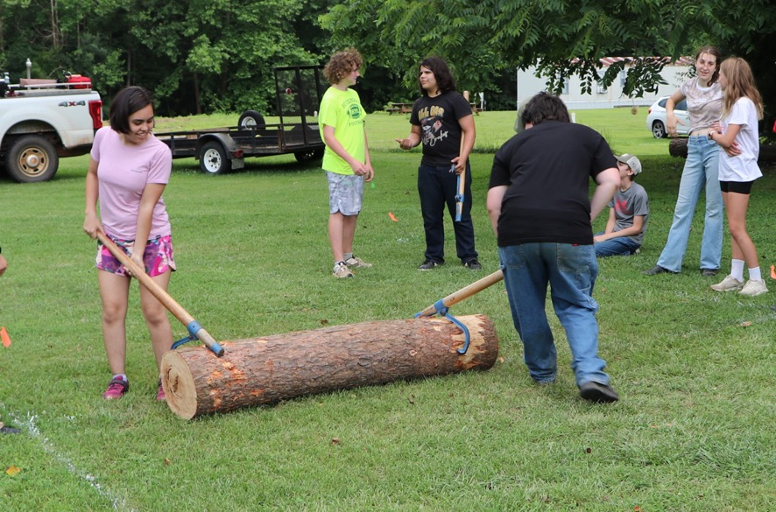

Slide 33
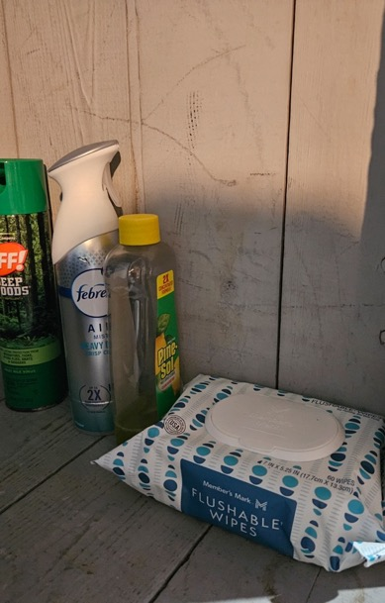
Now that’s clean!

Slide 34
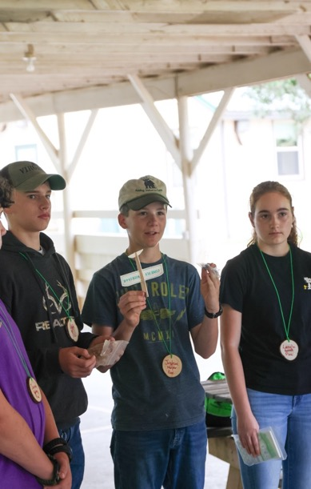

Slide 35
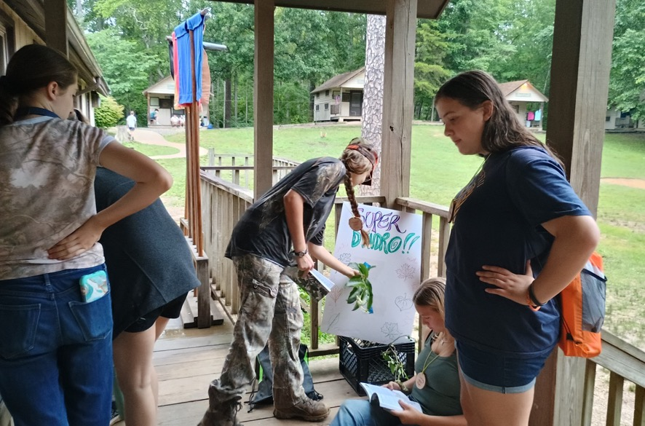
She thinks she’s a monkey?

Slide 36
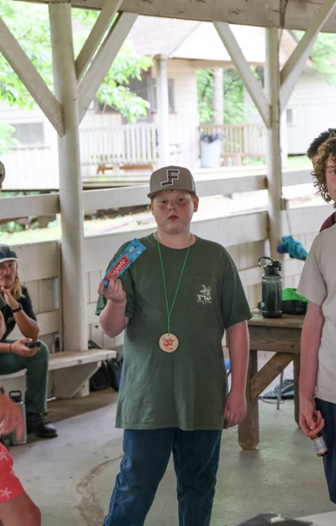
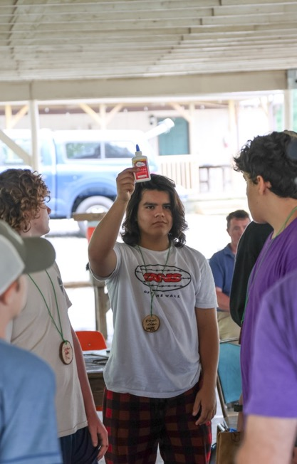
This is really made from trees?

Slide 37
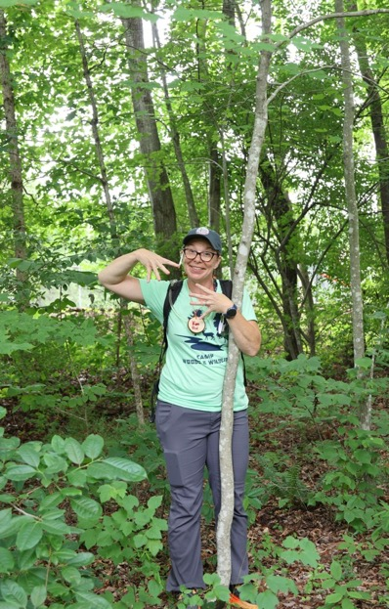
Too much caffeine?

Slide 38
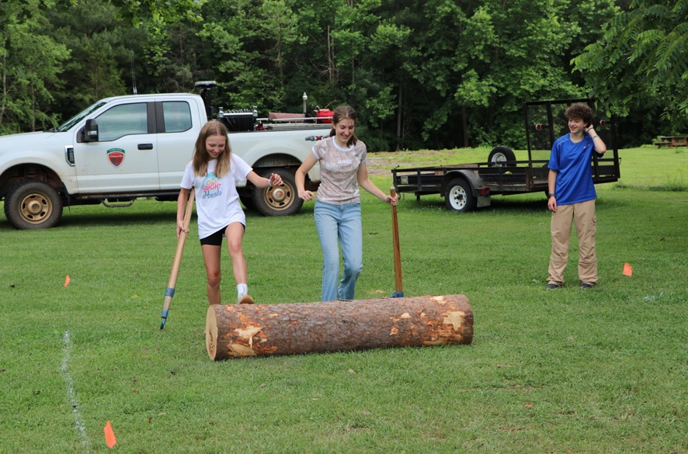

Slide 39
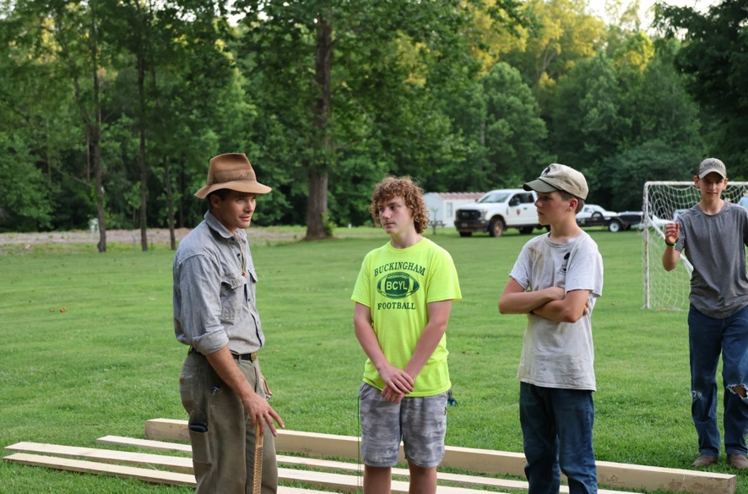
You related to Indiana Jones?

Slide 40
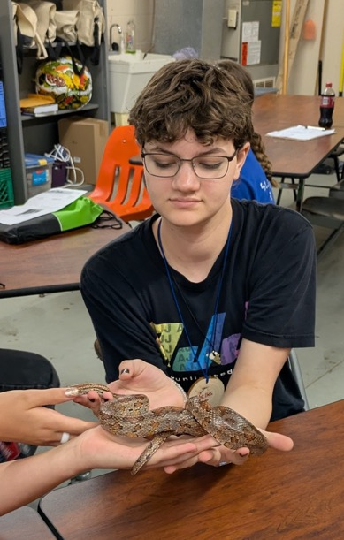

Slide 41
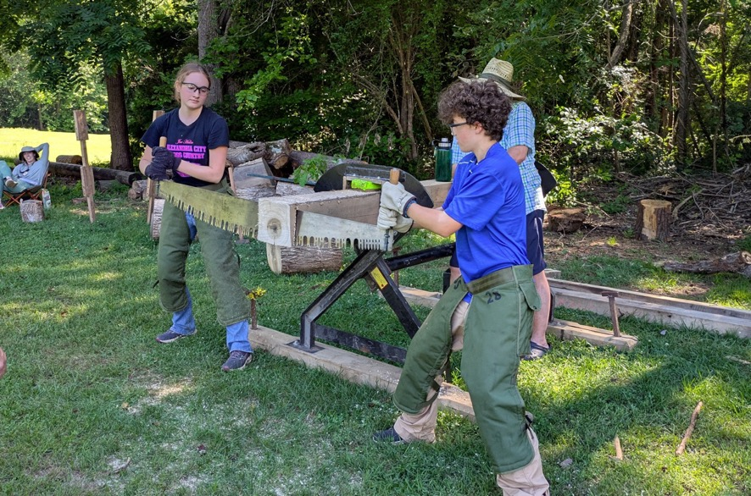

Slide 42
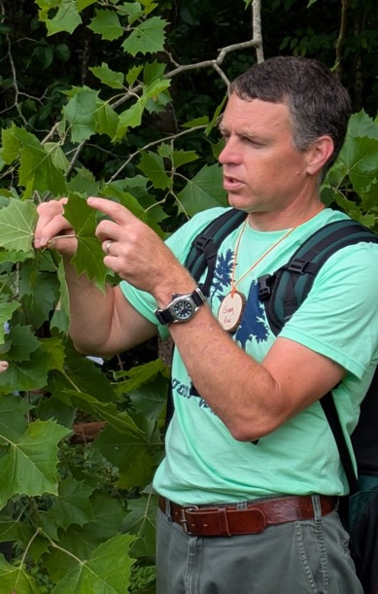
I love trees!

Slide 43
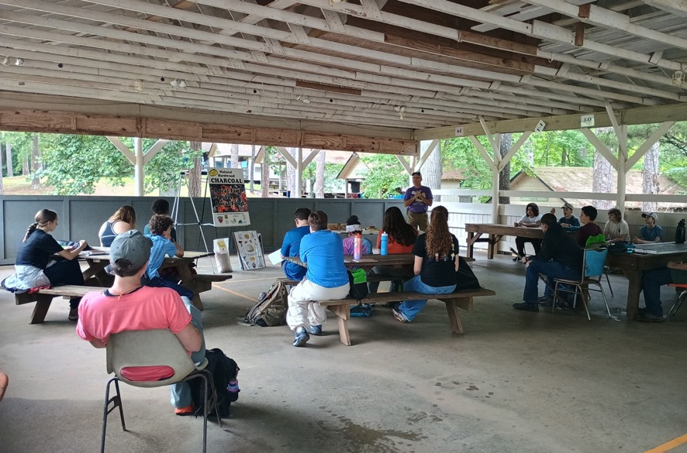

Slide 44
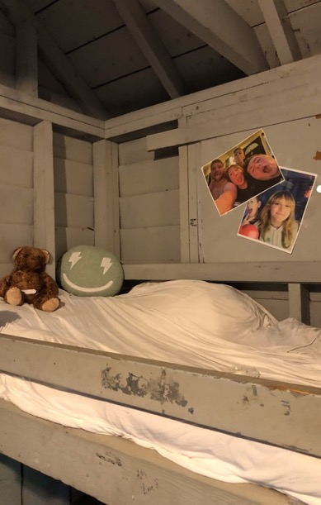
A little piece of home

Slide 45
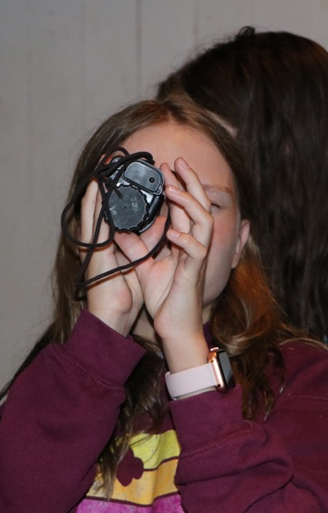
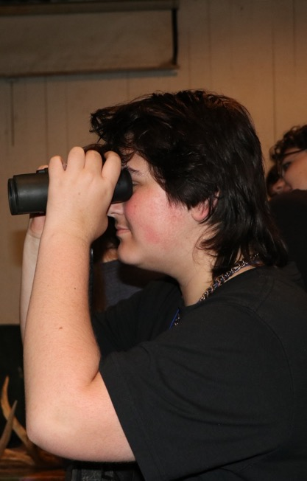

Slide 46


Slide 47


Slide 48

Smokey the Bear

Slide 49

I’m Loblolly. Are you?

Slide 50


Slide 51


Slide 52


Slide 53


Slide 54


Slide 55

Someone call for slime?

Slide 56


Slide 57


Slide 58


Slide 59


Yes, I see you!

Slide 60


Slide 61

Whatcha gonna do?

Slide 62


Slide 63

Makin’ the mom van look cool

Slide 64

You want us evacuate all these houses?

Slide 65

Isn’t he cute?

Slide 66

I love snakes

Slide 67


Slide 68

He’s just a baby

Slide 69


Slide 70



Slide 71

What have I got myself into?

Slide 72


Slide 73

Did y’all take showers?

Slide 74


Slide 75


Slide 76

Who broke the dozer?

Slide 77

This is too much like school
Watch for raptors…

Slide 78

Ahh, dinner

Slide 79

The camp hair salon

Slide 80


Slide 81


Slide 82

The arsonist strikes again!

Slide 83


Slide 84


Slide 85

The party van

Slide 86


Slide 87


Slide 88


Slide 89

JD to the rescue

Slide 90


Slide 91

This is a straight line?

Slide 92

Arrest that arsonist!

Slide 93

Can’t you go faster!

Slide 94

Finally, a little quiet

Slide 95


Slide 96

Where are you taking us?

Slide 97

This isn’t the volleyball court…

Slide 98

Just put the fire out!

Slide 99


Slide 100


Slide 101

We luv fishin’

Slide 102


Slide 103


Slide 104

I’m lovin’ camp

Slide 105


Slide 106

Let’s go!

Slide 107

This is work?

Slide 108


Slide 109


Slide 110


Slide 111

Hey Buc-ee!

Slide 112

3 ½ pounds, I thought it was bigger

Slide 113


Slide 114


Slide 115


Slide 116


Slide 117


Slide 118


Slide 119

Maybe I’ll sleep here tonight…

Slide 120

I want to be just like Goat!

Slide 121

Pull…Pull…
NBC News, why haven’t you put the fire out?

Slide 122


Slide 123


Slide 124


Slide 125


Slide 126


Slide 127


Slide 128


Slide 129

Needs a little decoration!

Slide 130


Slide 131


Slide 132

Are you evacuating all these homes?

Slide 133


Slide 134


Slide 135


Slide 136


Camper Time-out

Slide 137


Slide 138



Slide 139


Slide 140


Slide 141


Slide 142


Slide 143


Slide 144


Slide 145


Slide 146

No injuries please…

Slide 147


Slide 148


Slide 149


Slide 150


Slide 151


Slide 152

It’s only
day 2…
Just takes a little aim…

Slide 153


Arborists are cool

Slide 154


Slide 155


Slide 156


Slide 157


Slide 158

Where are my campers?

Slide 159


Slide 160


Slide 161


Slide 162


Slide 163

We luv trees!

Slide 164


Slide 165


Slide 166

Cheerios are better. Here fishy fishy.

Slide 167


Slide 168


Slide 169


Slide 170


Slide 171

I’ll show you how it’s done

Slide 172


Slide 173



Slide 174


Slide 175


Slide 176


Slide 177


Slide 178


Slide 179

I can beat his score

Slide 180

You sure he knows what he’s doing?

Slide 181


Slide 182


Slide 183


Slide 184


Slide 185


Slide 186

This is the best job!

Slide 187


Slide 188


Slide 189


Slide 190


Slide 191

How many campers can we fit in a bear trap?

Slide 192


Slide 193


Slide 194


Slide 195


Slide 196

This is how you make it look bigger

Slide 197

This is so cool!

Slide 198

We’re gonna need more water

Slide 199


Slide 200


Slide 201


Slide 202


Slide 203

It’s just a baby!

Slide 204


Slide 205


Slide 206


Slide 207


Slide 208


Slide 209


Slide 210


Slide 211


Slide 212

That’s the most stylish throw

Slide 213


Slide 214


Slide 215


Slide 216


Slide 217


Slide 218


Slide 219


Slide 220


Slide 221

I hear you Uncle Dave

Slide 222


Slide 223


Slide 224


Slide 225


Slide 226


Slide 227


Slide 228


Slide 229


Slide 230


Slide 231

It’s all about the trees

Slide 232


Slide 233


Slide 234


Slide 235


Slide 236

The campers can push

Slide 237


Slide 238


Slide 239


Better check for ticks!

Slide 240

They think they’re talking on a phone

Slide 241


Slide 242

The beetle is comin’ to get you

Slide 243

This isn’t a real chainsaw

Slide 244


Slide 245

2025 #1
Top Camper

Slide 246
Camp Woods
& Wildlife
To
New Friends,
New Knowledge and
New Experiences

