Slide 1
Research to Bring Back a Resistant American Chestnut
Lesesne State Forest, Nelson County

Slide 2
Pure American Chestnut Planted at Lesesne State Forest
Thompson
Ragged Mountain

Slide 3
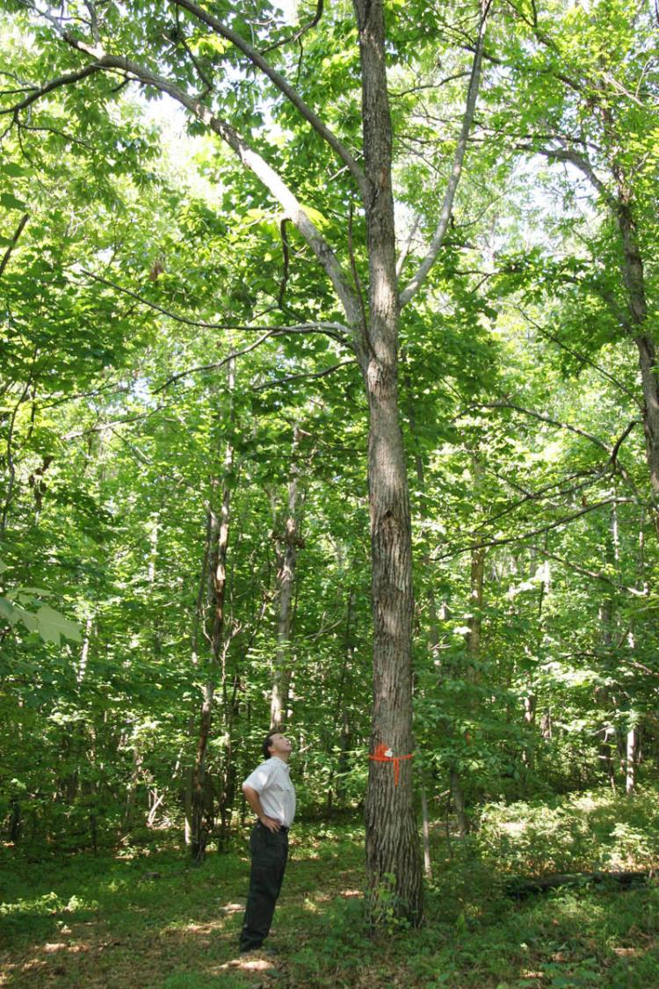
Hybrid Chestnut Planted at Lesesne State Forest
Notes:
Jerre Creighton

Slide 4
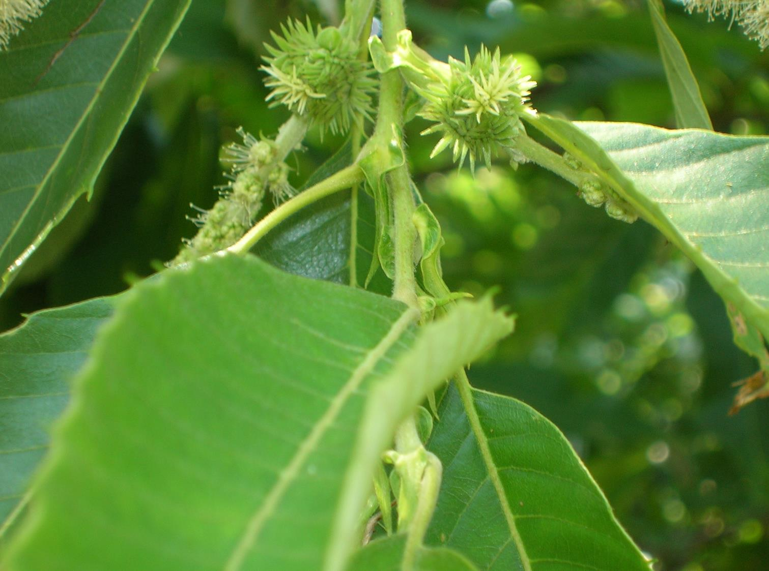
Hybrid Chestnut Flowers Ready for Pollination

Slide 6
Pure American Chestnut

Slide 9
Female
Chestnut Burr

Slide 10
Male Catkin

Slide 12
Protecting from Unknown Pollen

Slide 14
Hybrid Chestnut Orchard at Lesesne State Forest

Slide 16
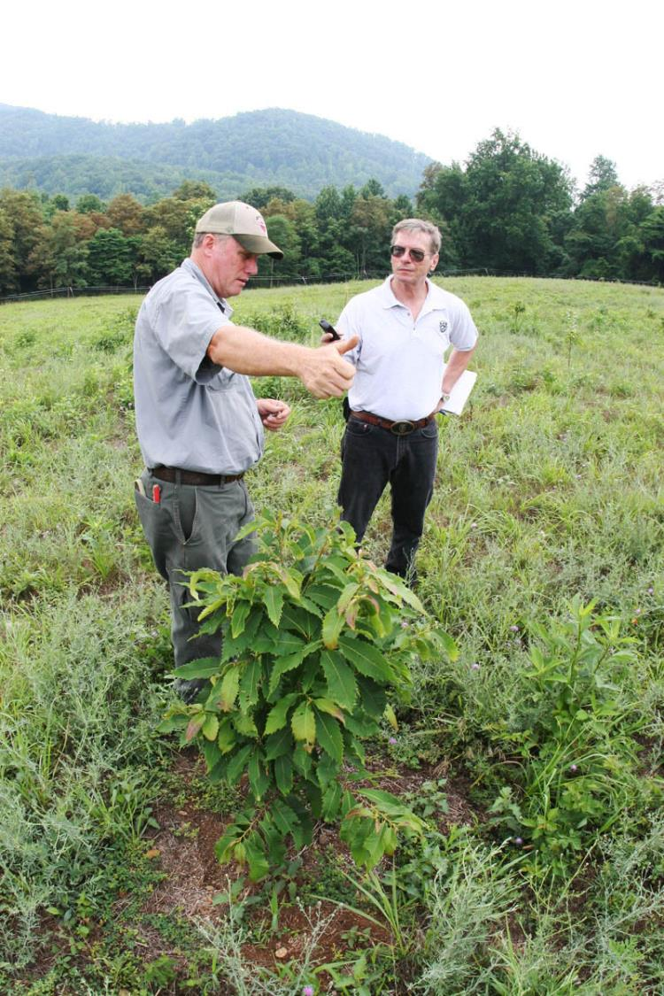
Hybrid Chestnut Seedlings at Lesesne State Forest

