Slide 1
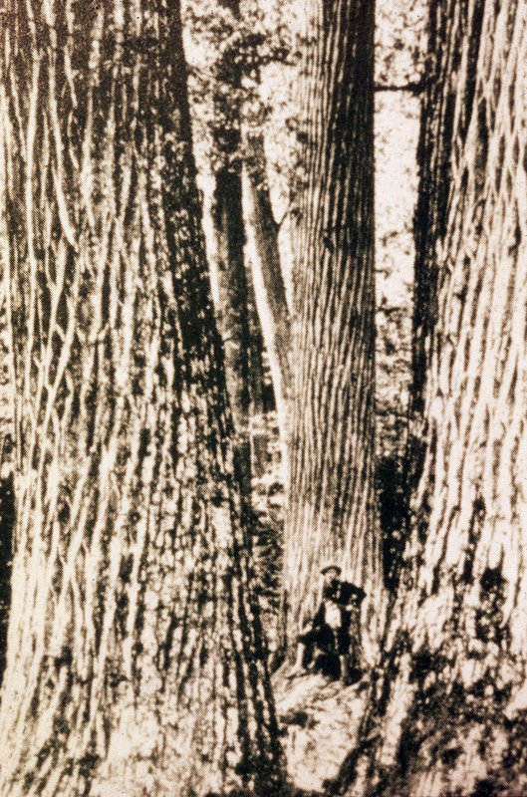
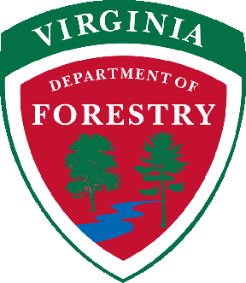
History of American Chestnut Restoration

Slide 2
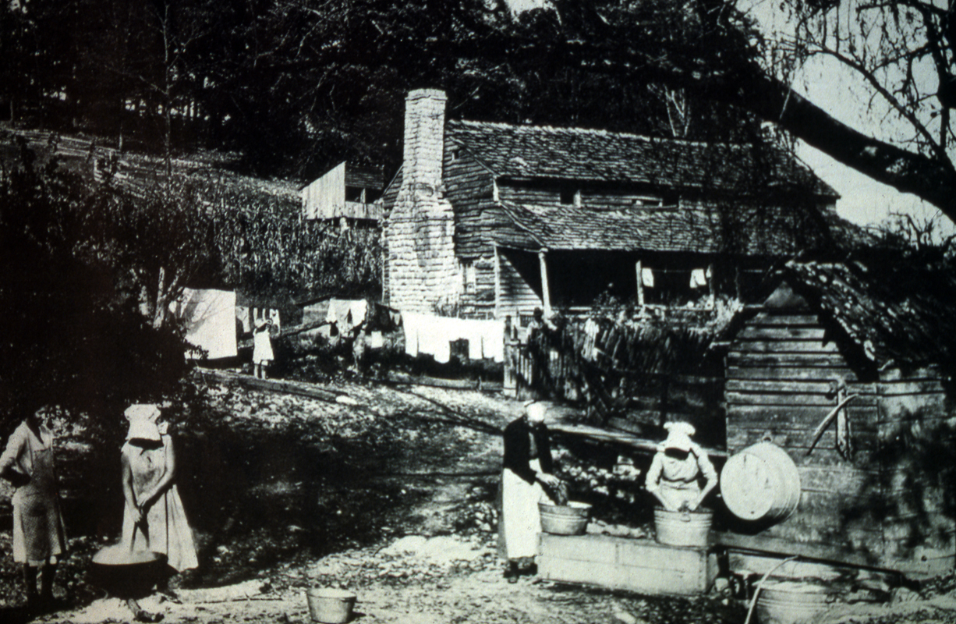
For our pioneer nation, American Chestnut was almost the perfect tree. It was a high-quality, easily-worked, decay-resistant wood. It was a livestock and human food source. The bark was used for preserving leather.

Slide 3
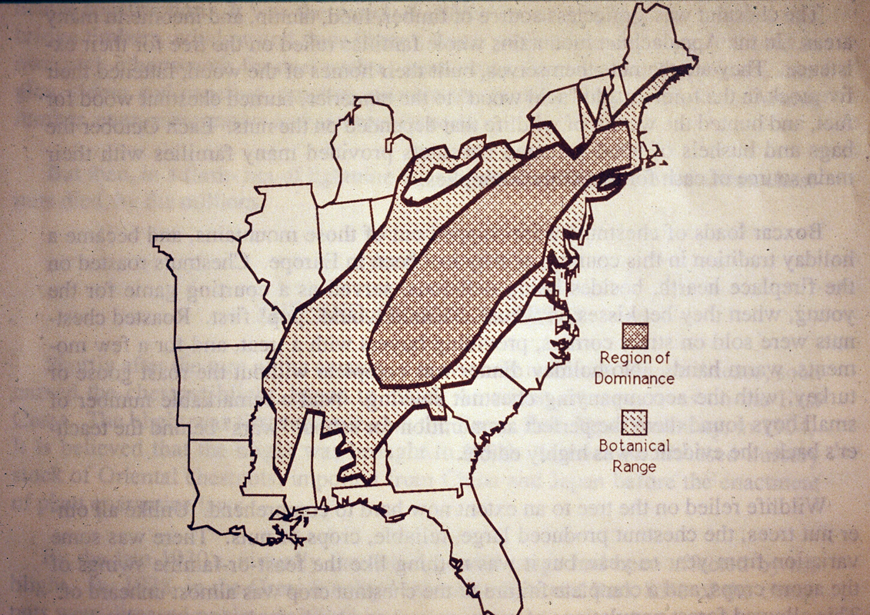

Slide 4
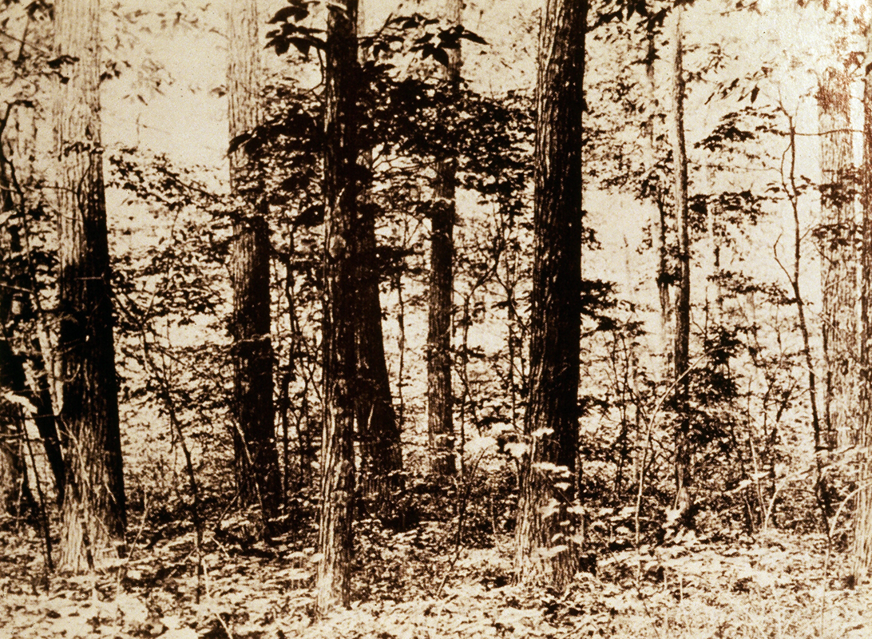
American Chestnut was dominant on average or below-average sites.

Slide 5
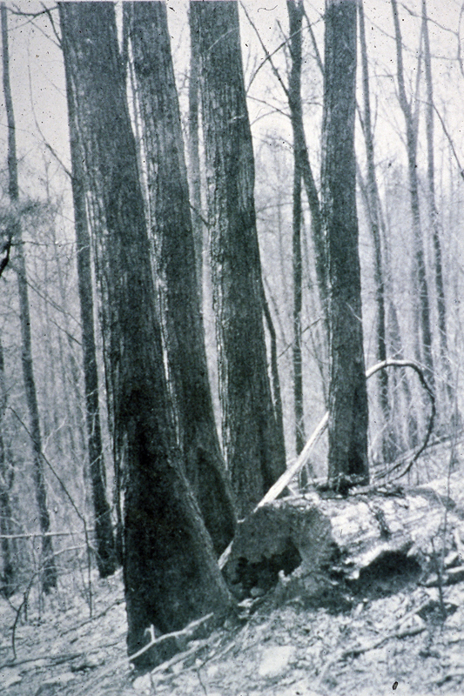
Despite the blight, it still keeps sprouting for more than 50 years.

Slide 6
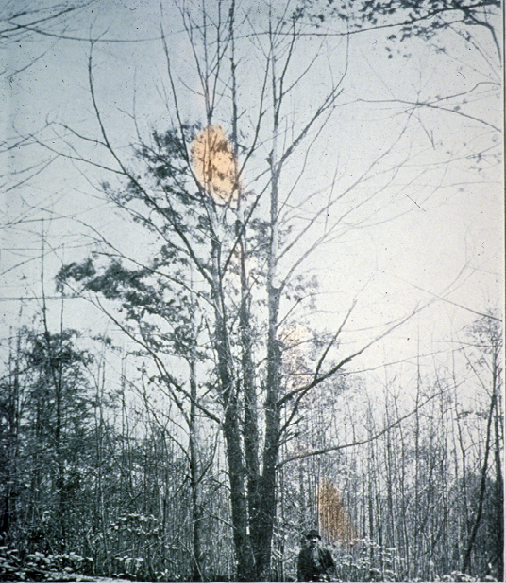
Chestnut blight was first seen on American Chestnut in New York City in 1908.
Chestnut blight most likely came to New York City on an infected Chinese Chestnut nursery stock.
By 1950, most of the American Chestnut trees had essentially disappeared from the forest.

Slide 7
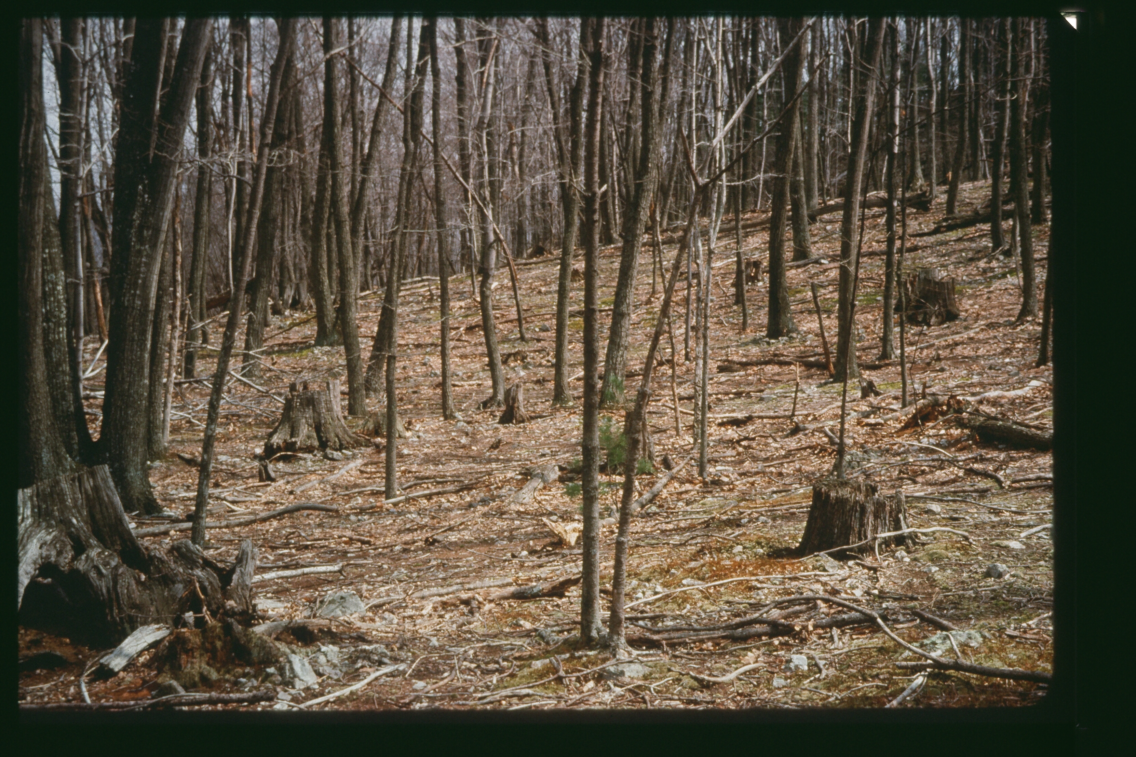
American Chestnut stumps - 60+ years old, Madison County

Slide 8
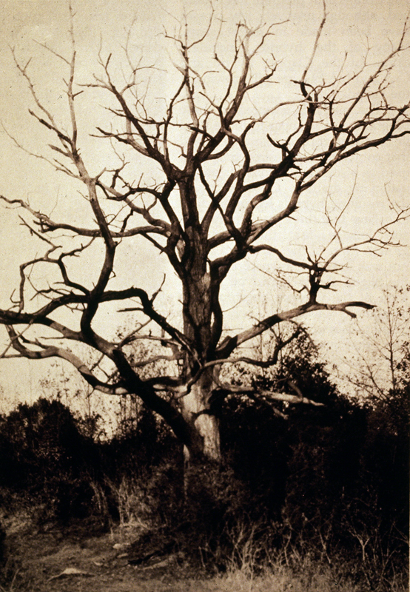
The most valuable hardwood tree in the U.S. was removed from the forest in less than 50 years

Slide 9
What does the blight look like?

Slide 10
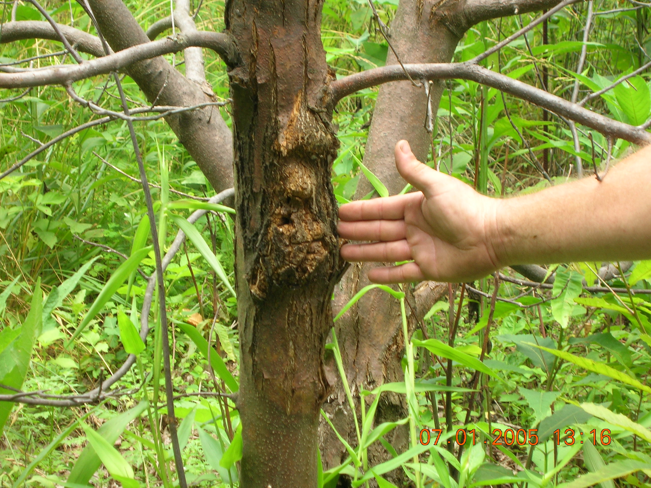

Slide 11
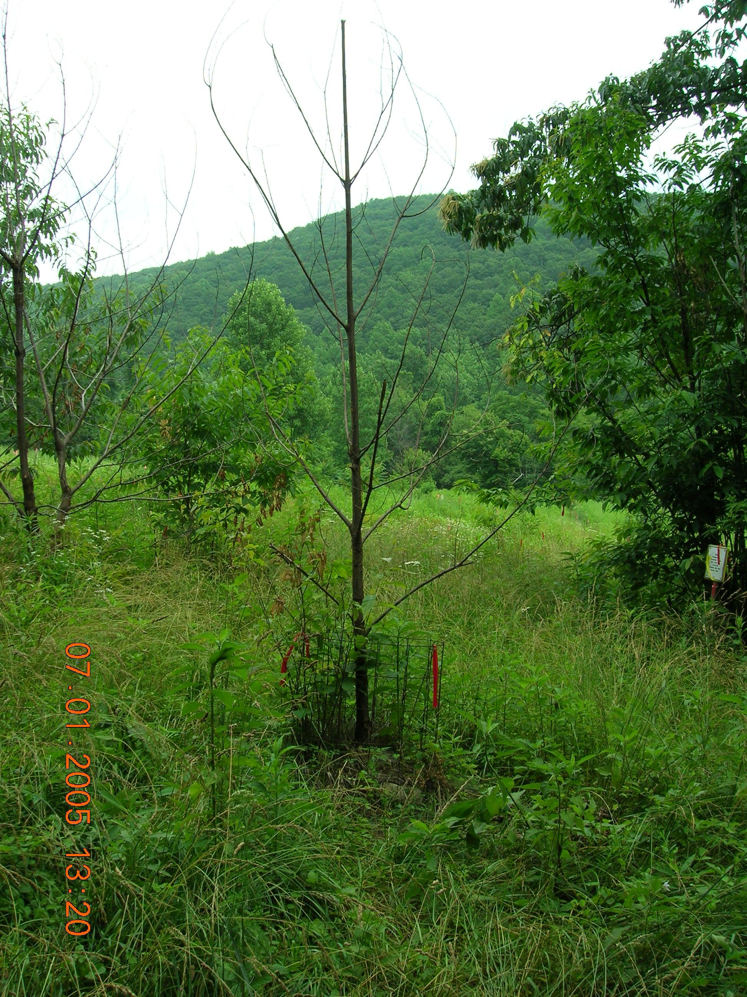

Slide 12
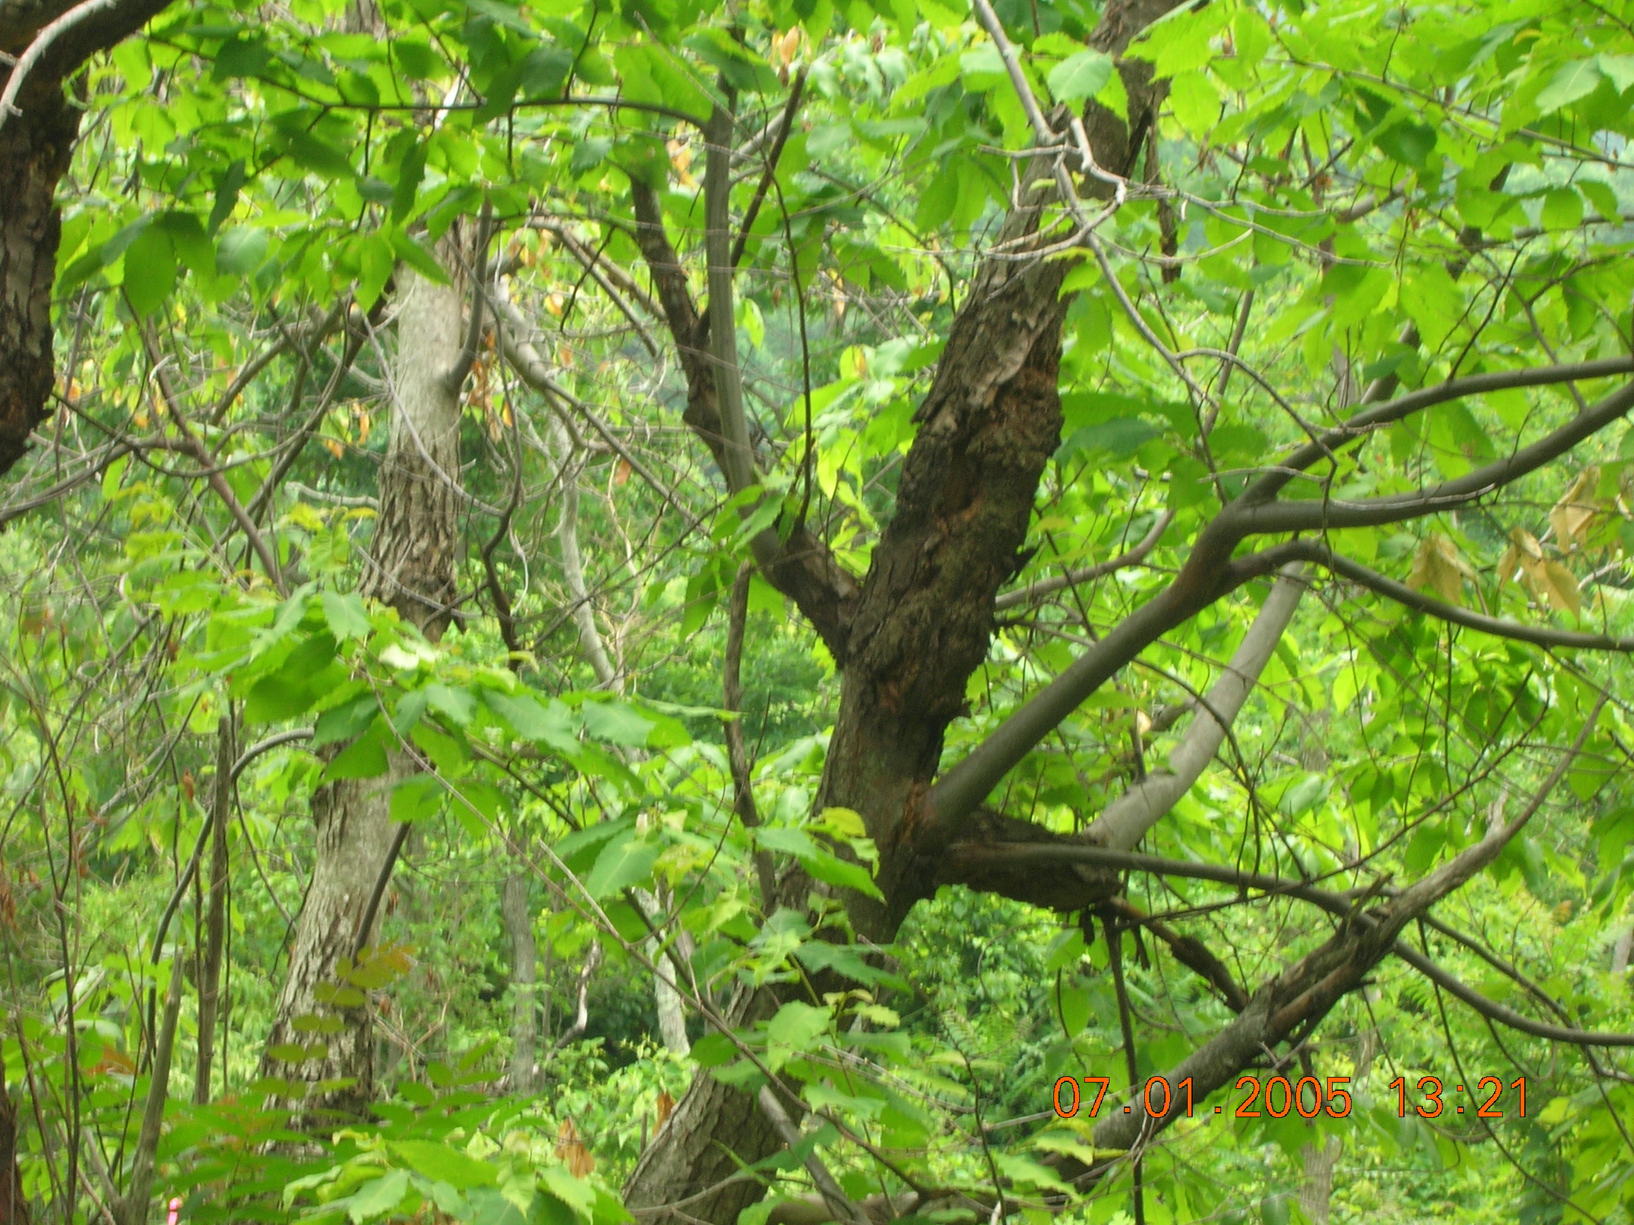

Slide 13
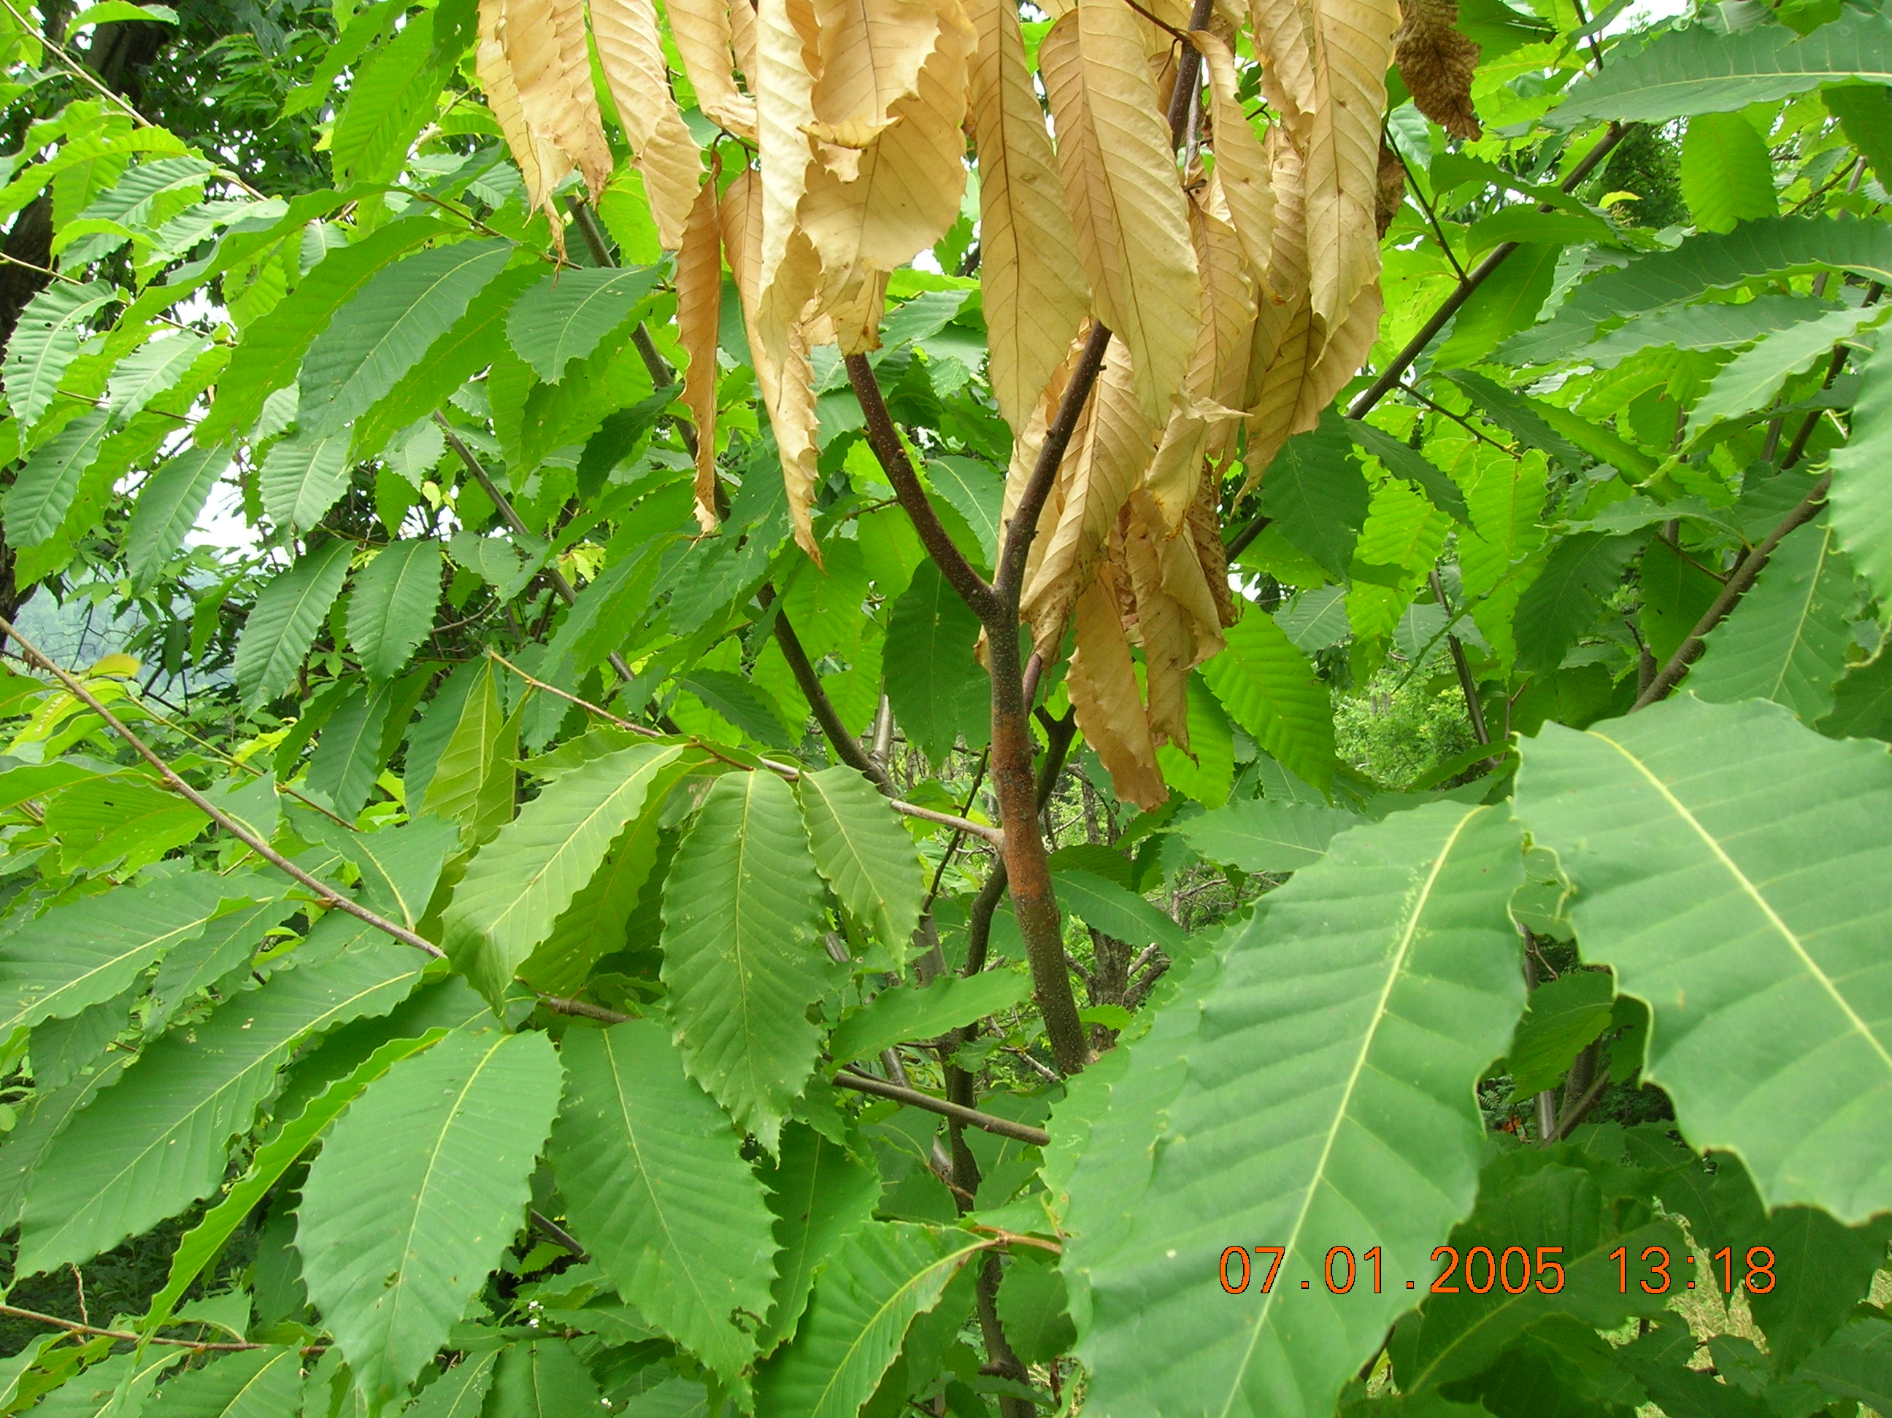

Slide 14
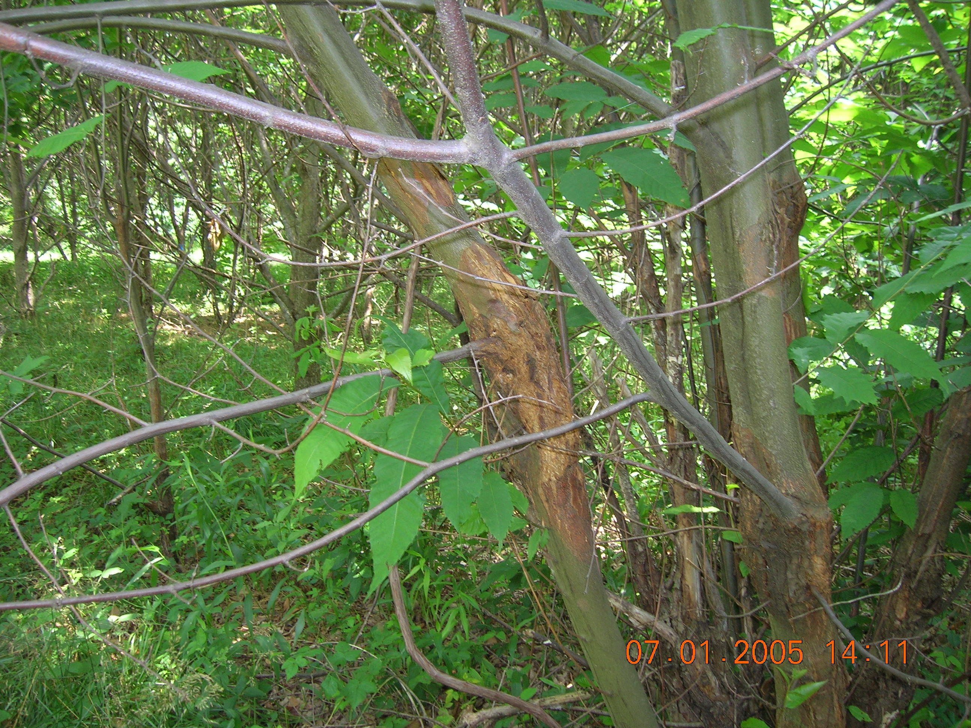

Slide 15
Attempts were made to stop it.

Slide 16
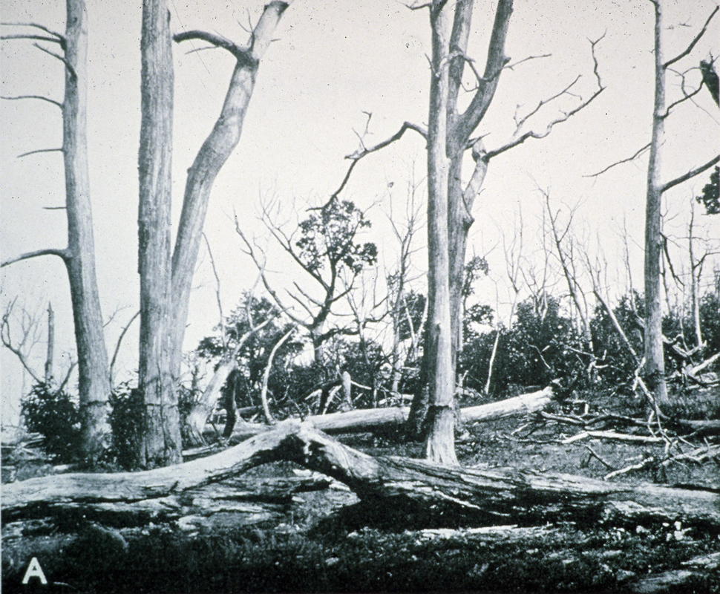
The CCC cut a mile-wide-area of uninfected Chestnuts in Pennsylvania. All attempts to control the blight failed.

Slide 17
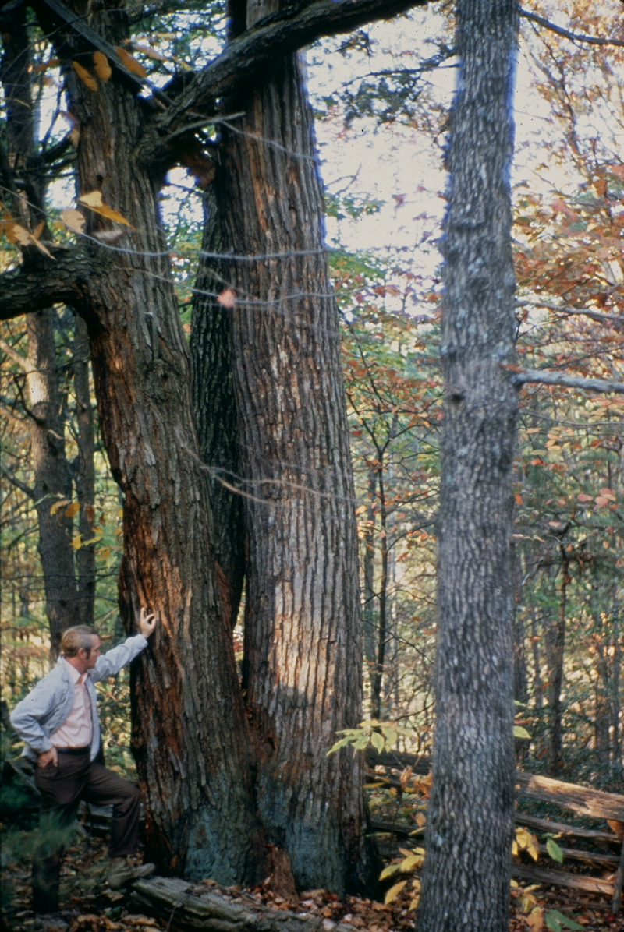
Nearly every tree was infected.
There may be 100 still alive. Perhaps there is some very weak disease resistance?

Slide 18
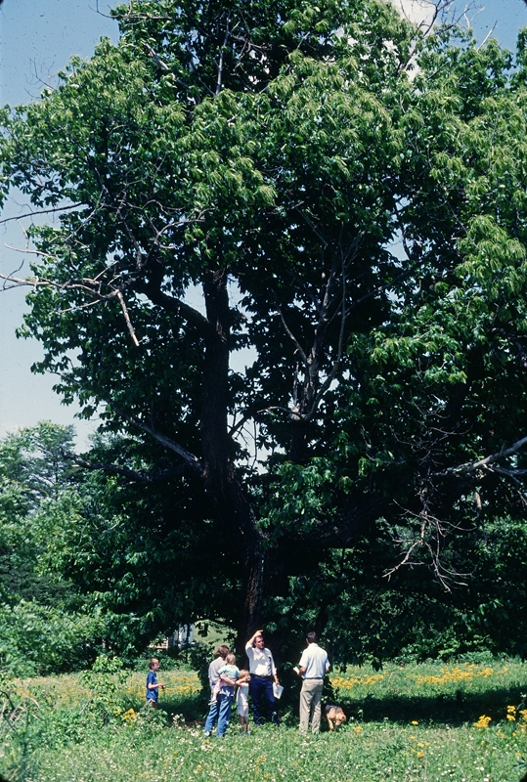
The “Ross Tree” in Amherst County is infected with the Blight.
It might have some resistance since it is still alive.
It is being used in a breeding program to build a blight free American Chestnut Tree

Slide 19
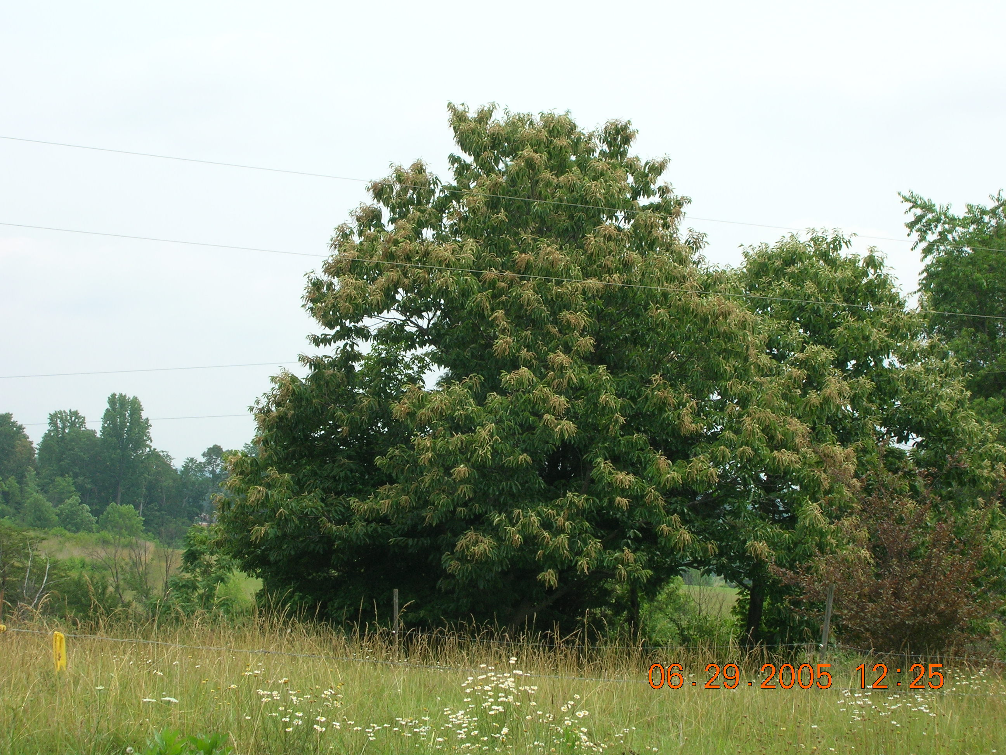
The American shape is more of a tree form.

Slide 20
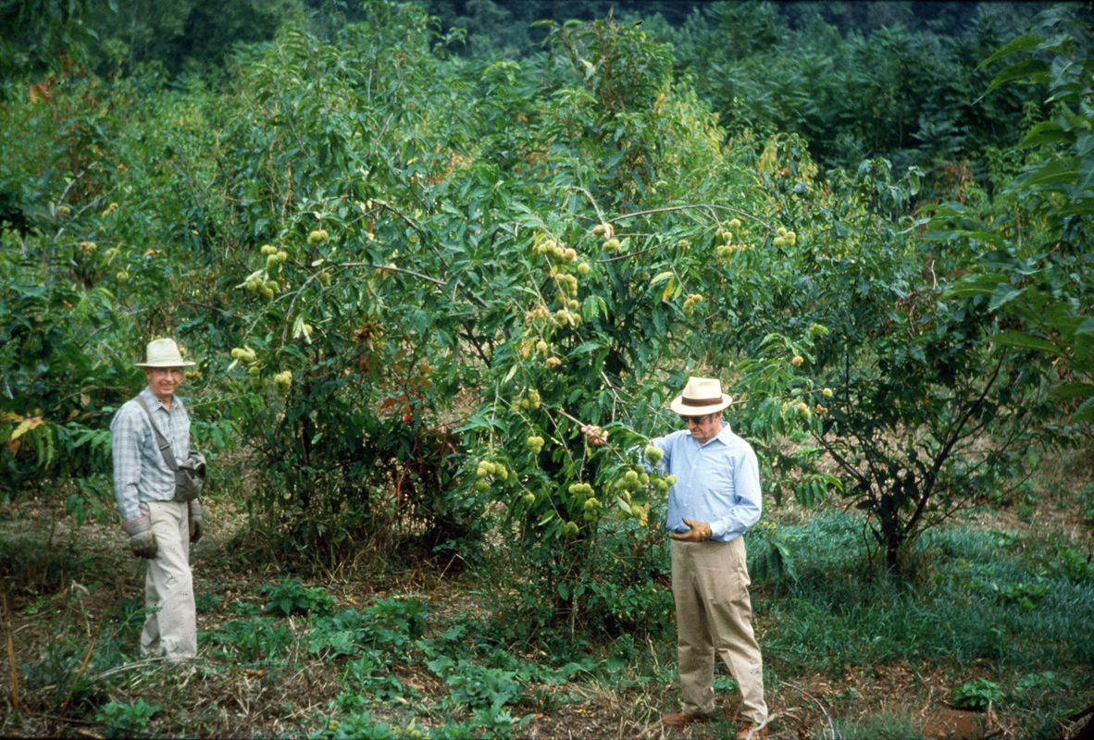
The Chinese is more like a bush.

Slide 21
The Chinese Chestnut has good blight resistance, but poor form.

Slide 22
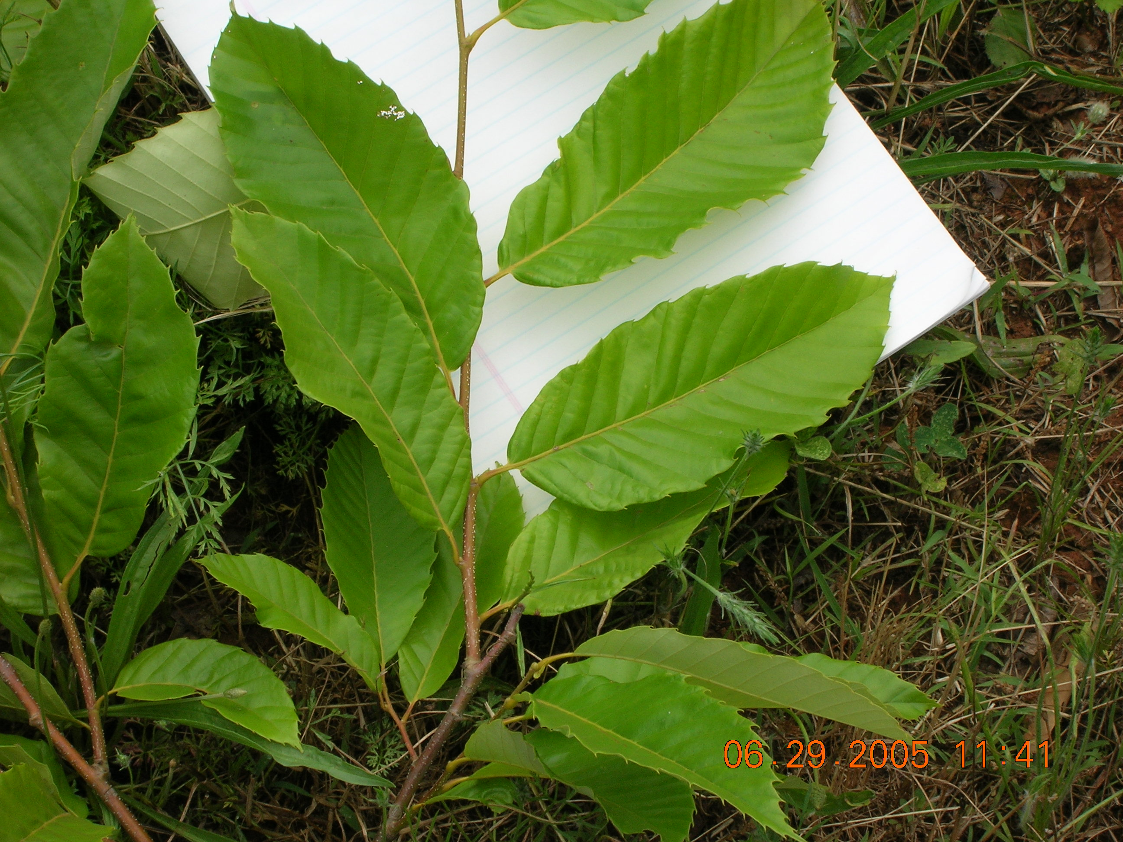
Chinese

Slide 23
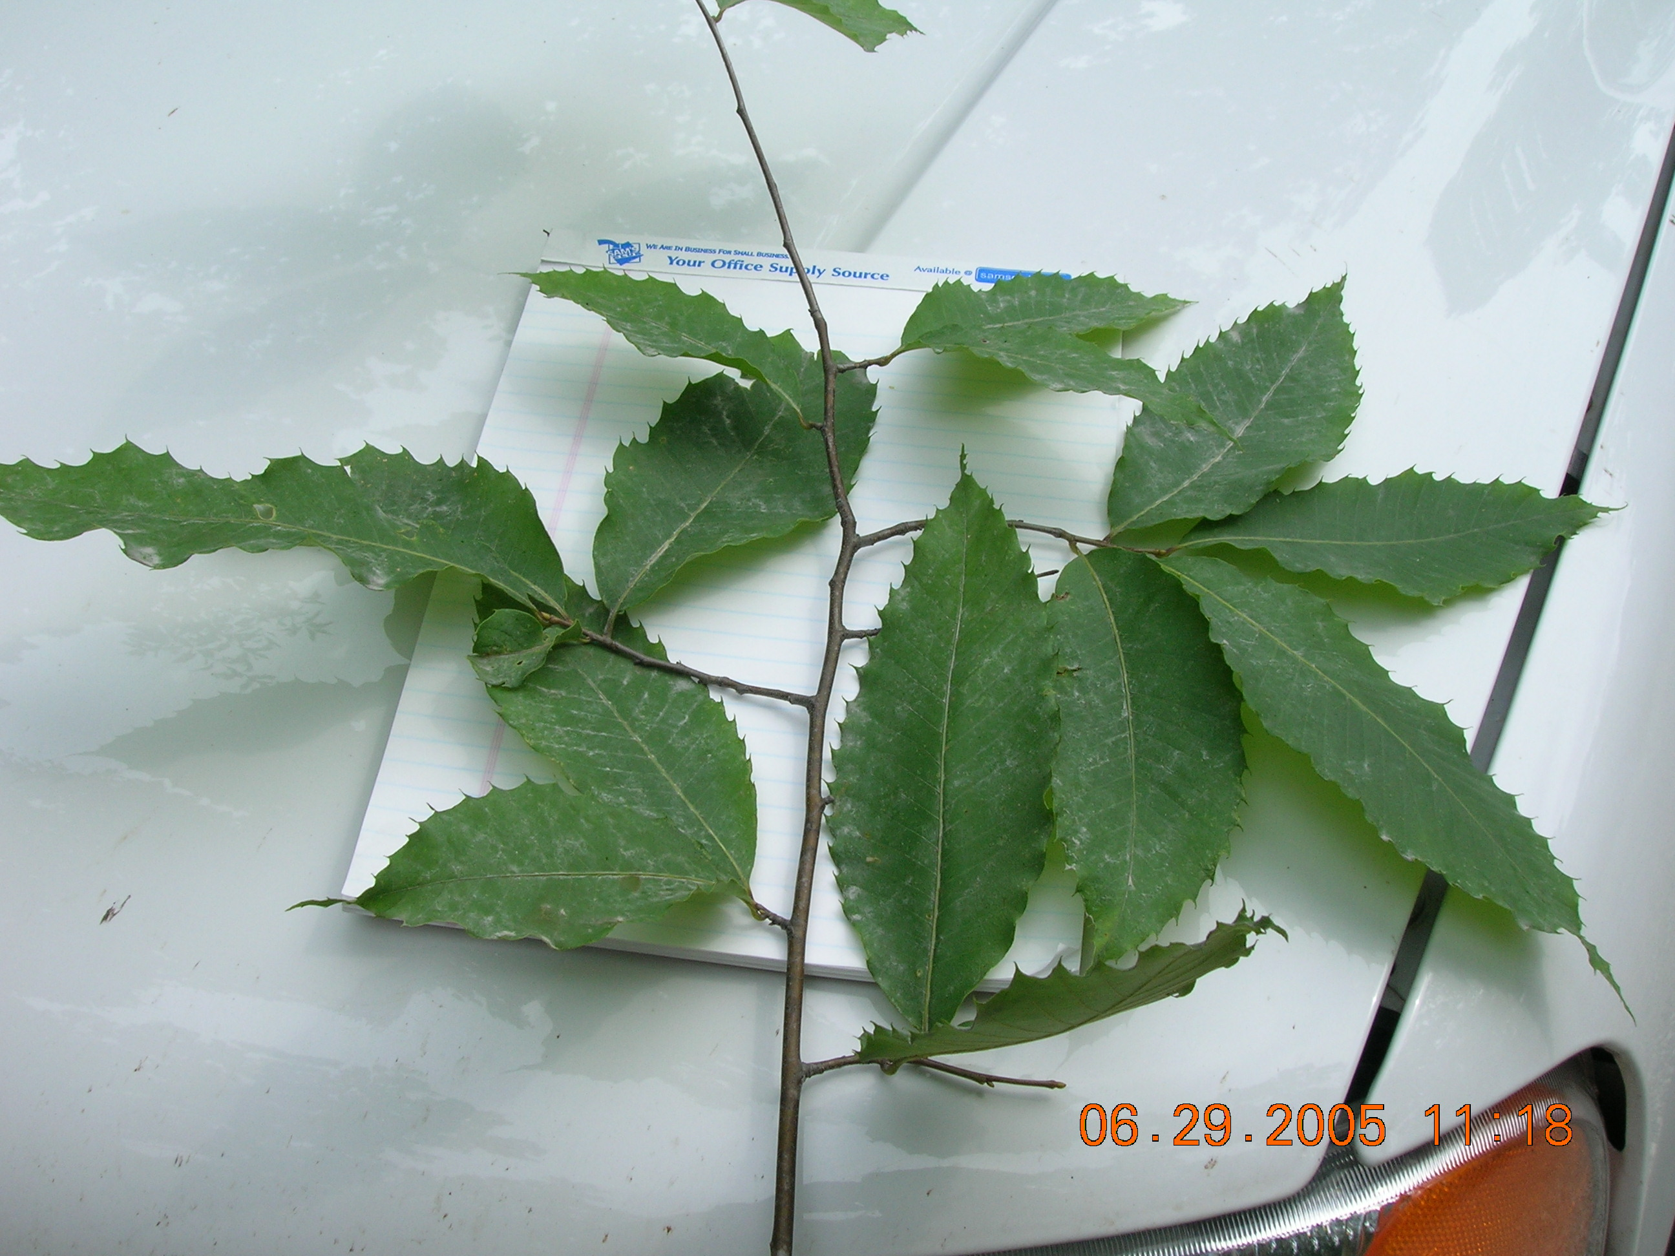
American

Slide 25
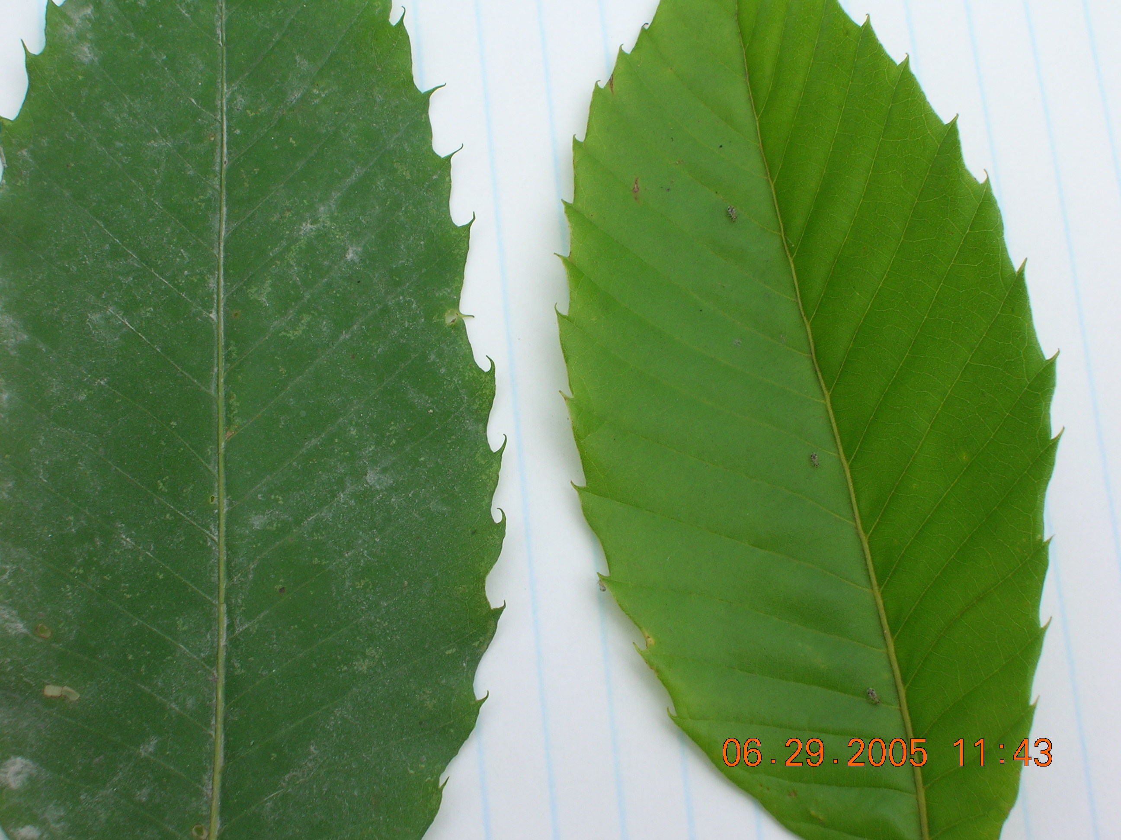

Slide 26
How do you breed blight resistance into the American Chestnut and retain the quality American tree form?

Slide 27
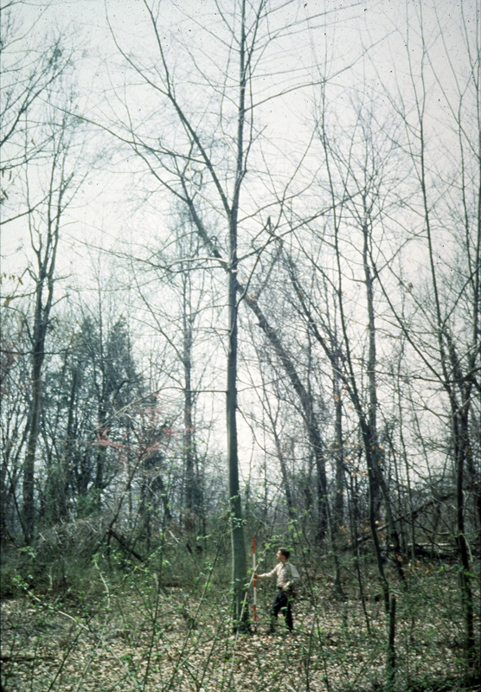
Cross Pollinate American X Chinese - easy…
At one time, it was thought that disease resistance and tree form were “linked.”
It might be impossible to grow an American Chestnut with blight resistance.

Slide 28
How to breed blight resistance into the American Chestnut and retain the quality American Tree Form?

Slide 29
The Lesesne State Forest is dedicated to the American Chestnut research. 1969 was the first year that work was started on the Lesesne.

Slide 30
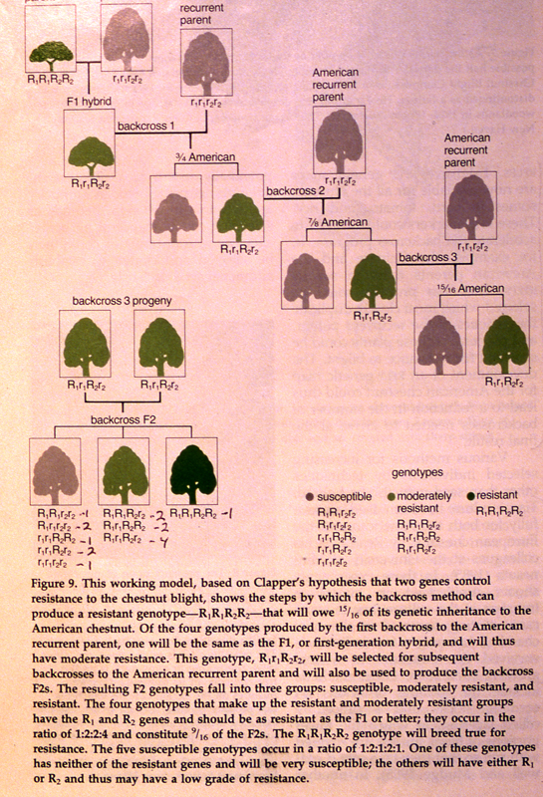
The Breeding model used by the VDOF and American Chestnut Foundation
American Chestnut will be growing with disease resistance equal to Chinese Chestnut

Slide 31
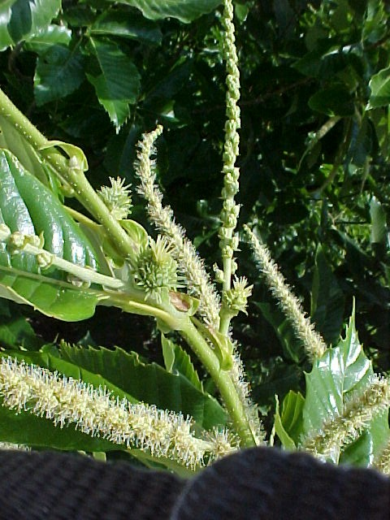
American Chestnut has both sexes on an individual tree.
Chinese has both too.

Slide 32
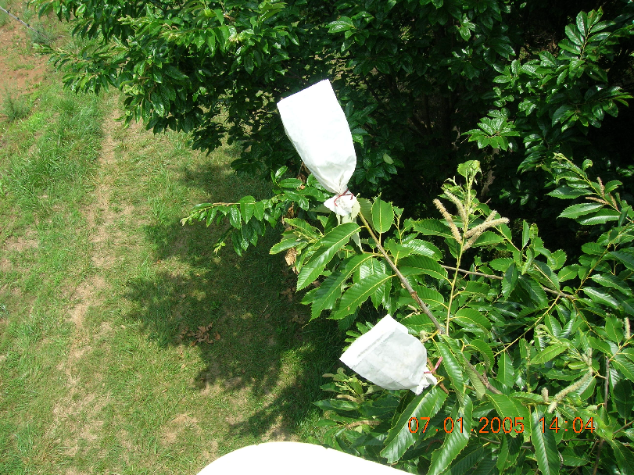
Before pollen sheds and female flower receptivity begins, the female flowers are covered with paper bags to keep off foreign pollen.

Slide 33
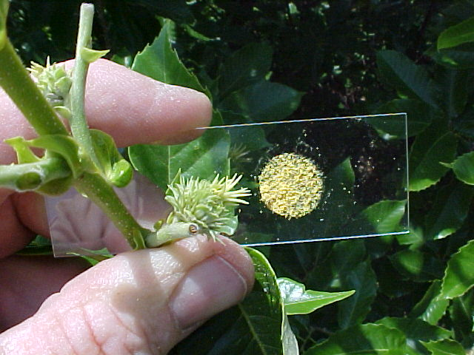
Controlled pollination is the method used to produce blight-resistant trees. Pollen from surviving pure American Chestnut is collected and applied by hand to Chinese Chestnut “flowers”.

Slide 34
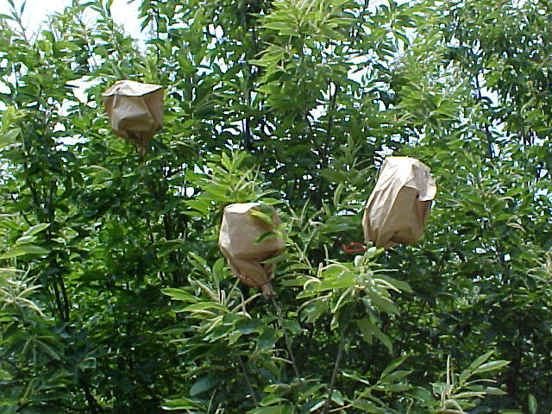
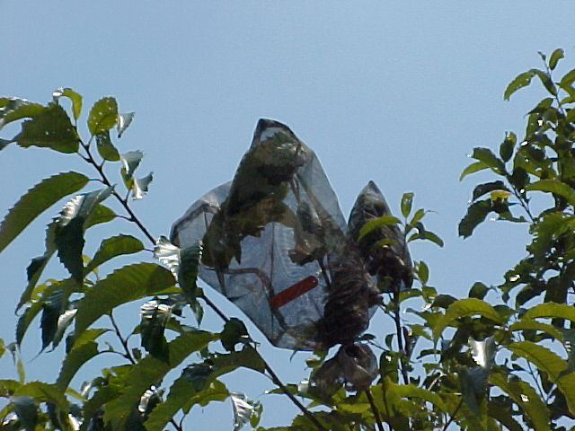
Pollen collections, flower bagging and the controlled pollinations are done in early summer to mid-June on the Lesesne State Forest in Nelson County.

Slide 35
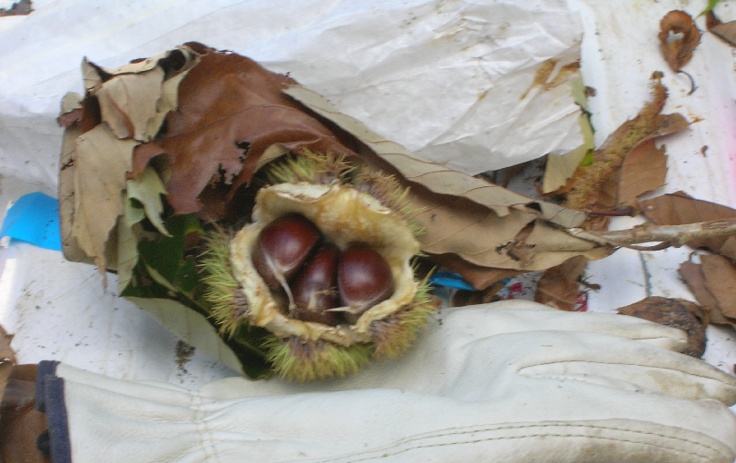
The flowers and nuts mature in one growing season.

Slide 36
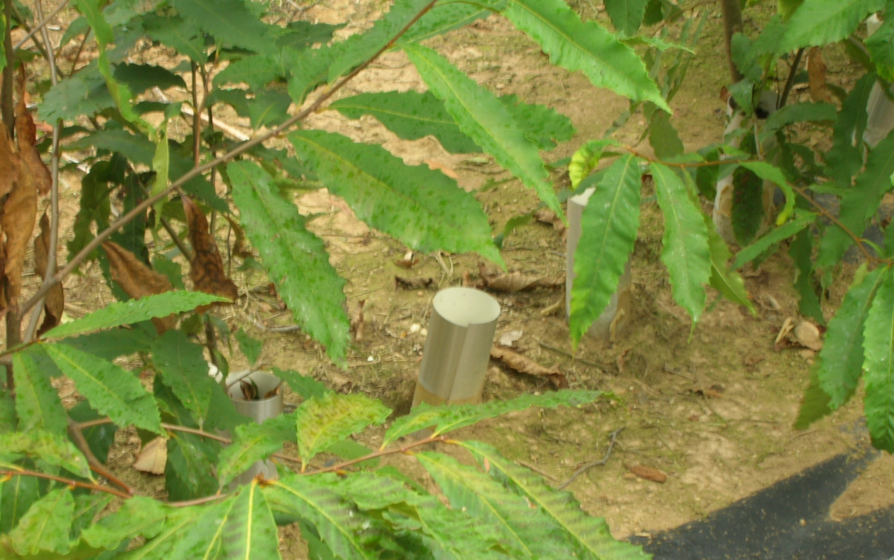
The nuts are collected and planted at the Matthews State Forest.

Slide 37
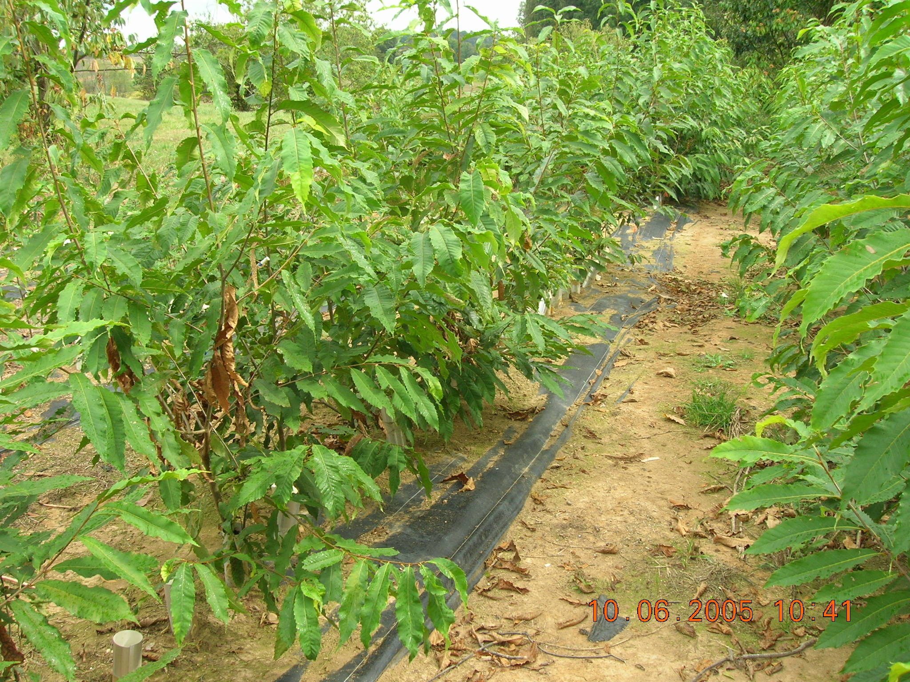
Then… we wait for growth and look for disease resistance.

Slide 38
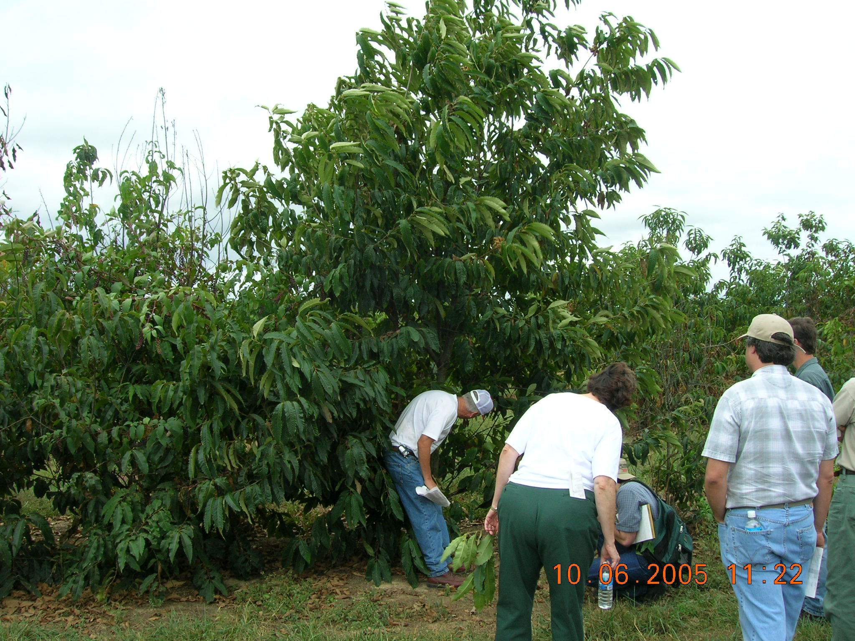

Slide 39
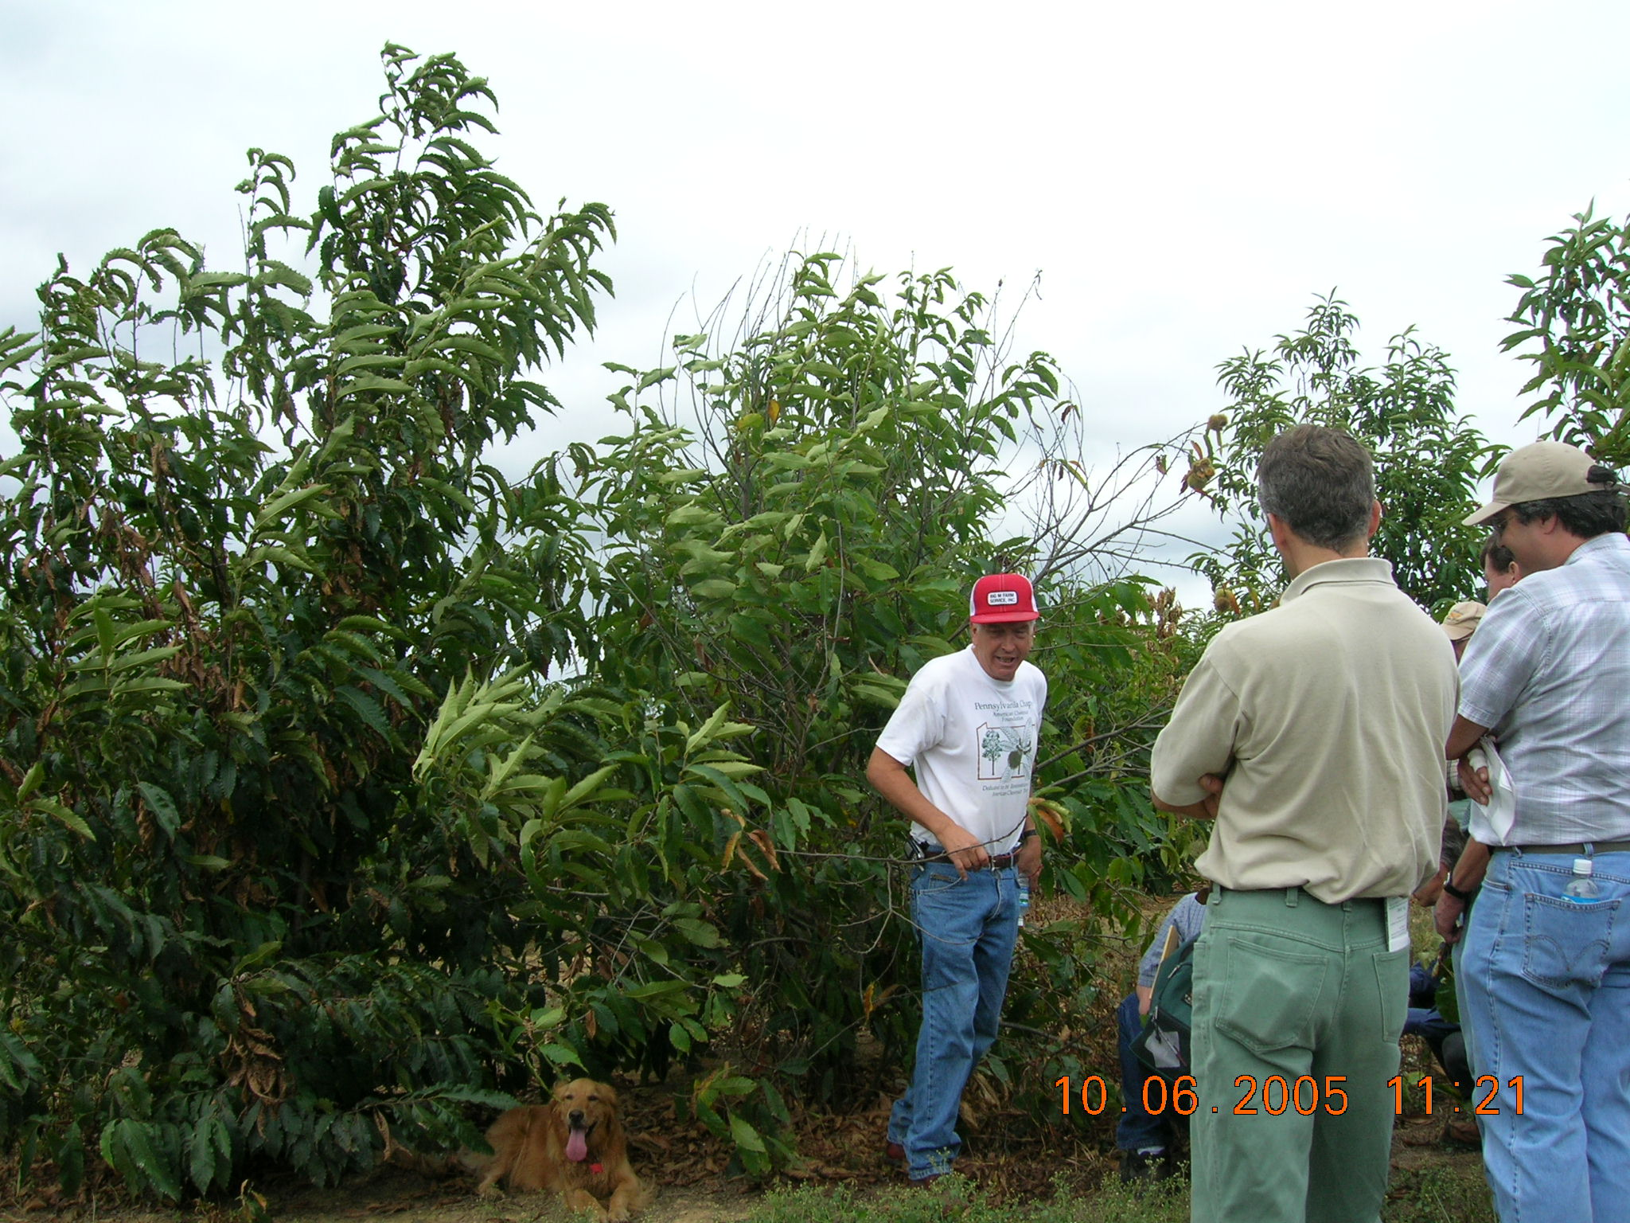

Slide 40
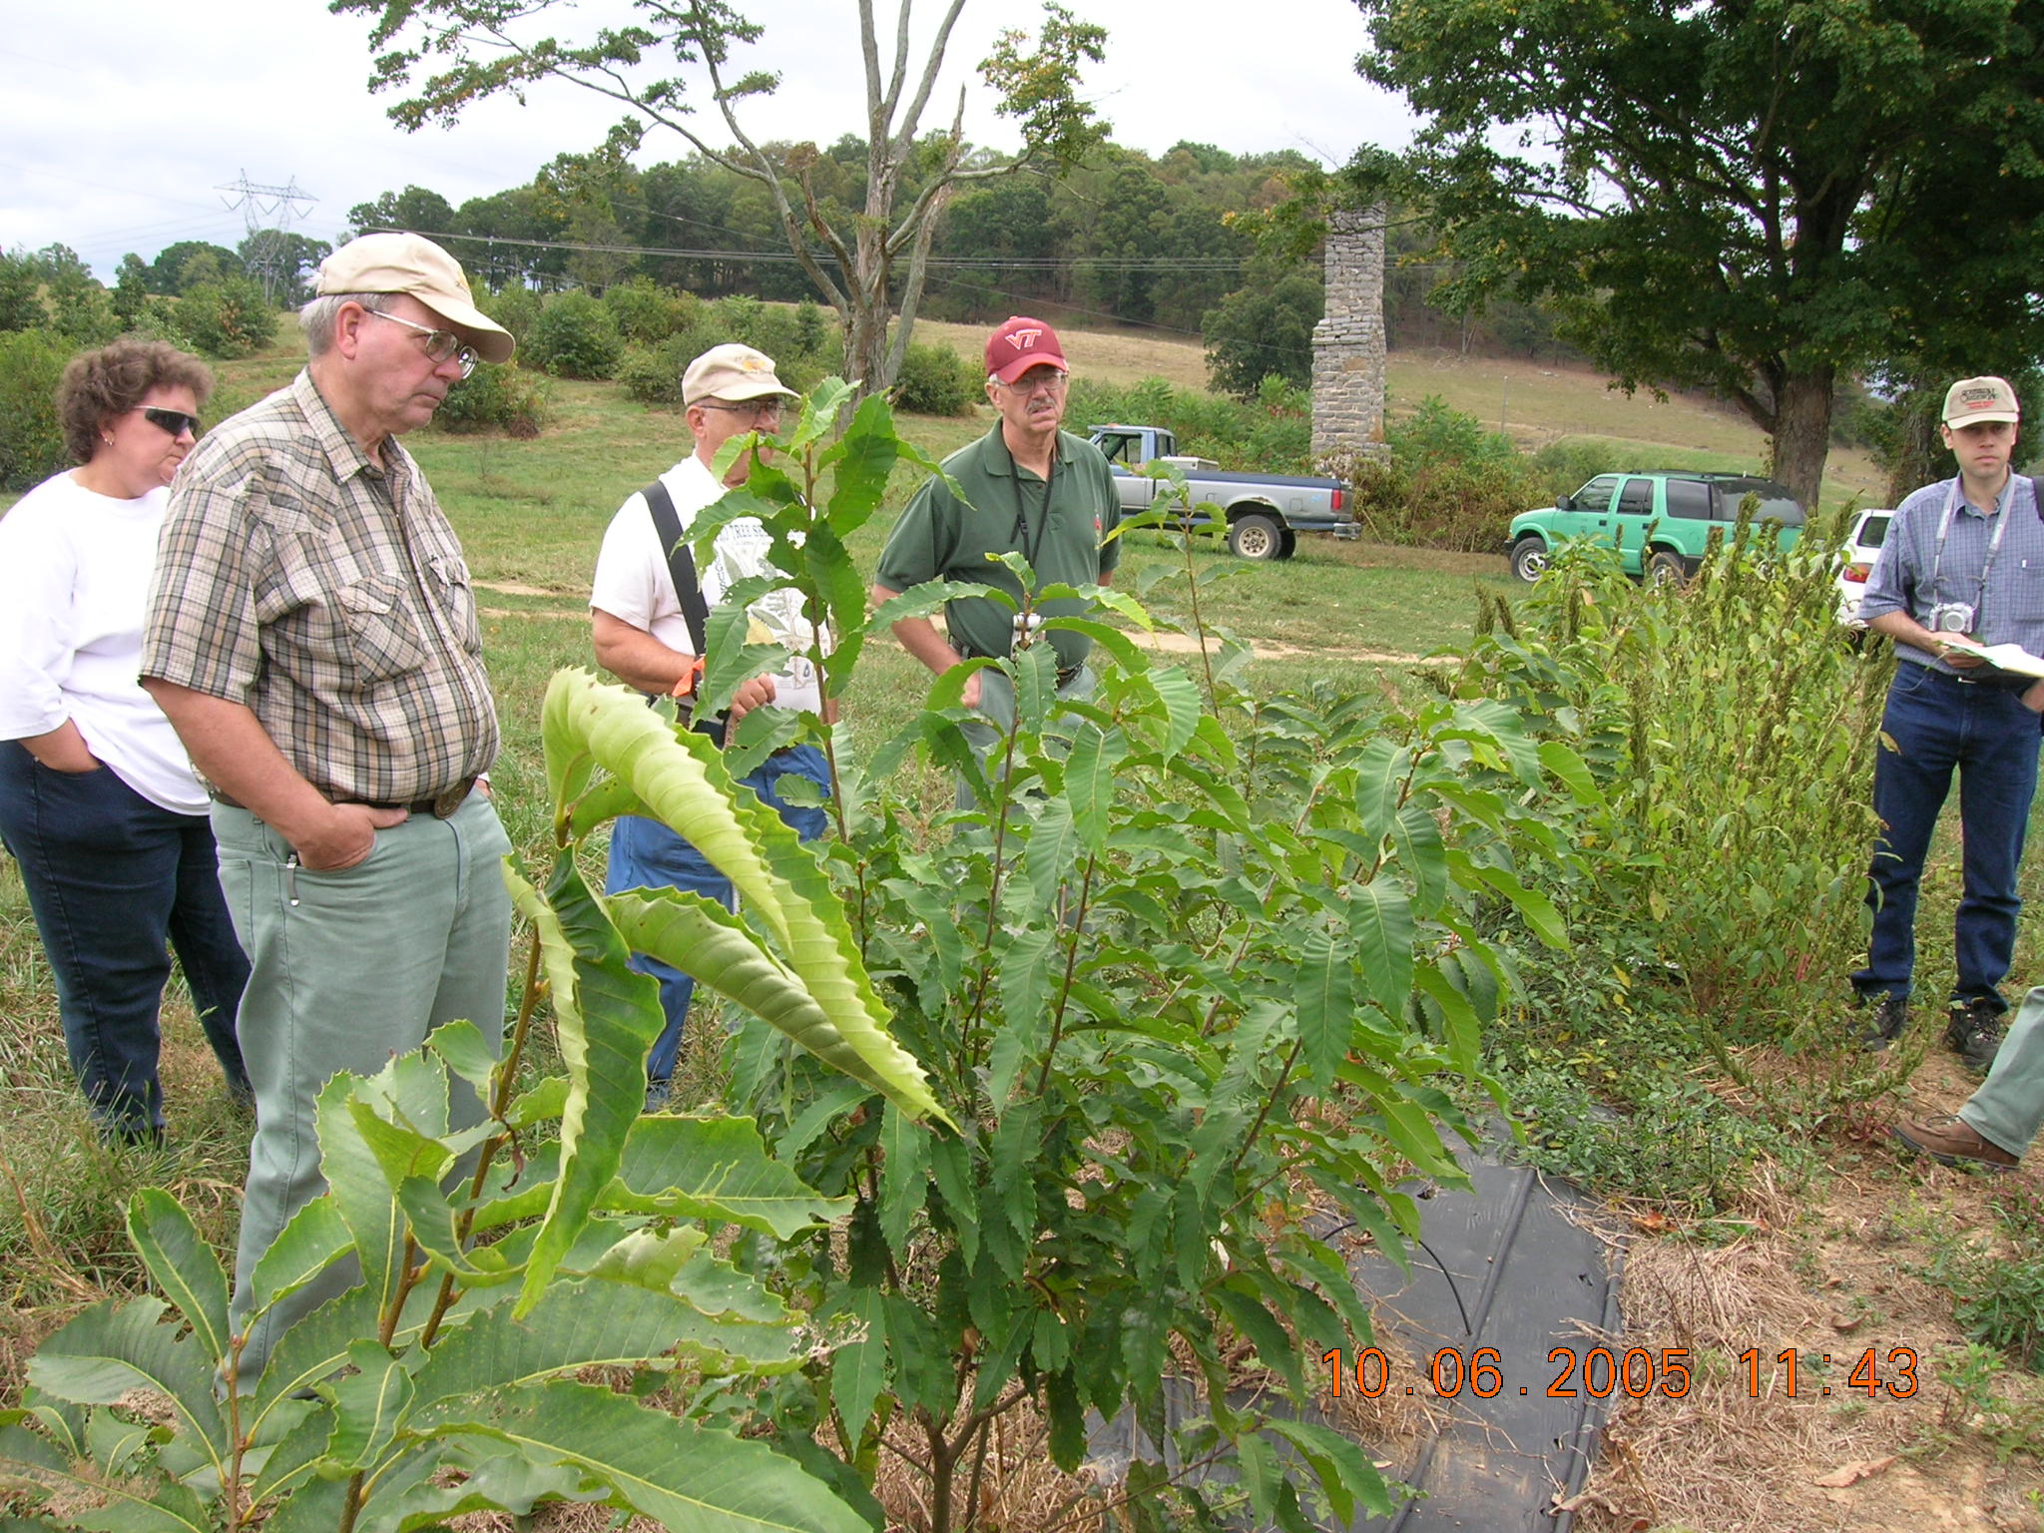

Slide 41
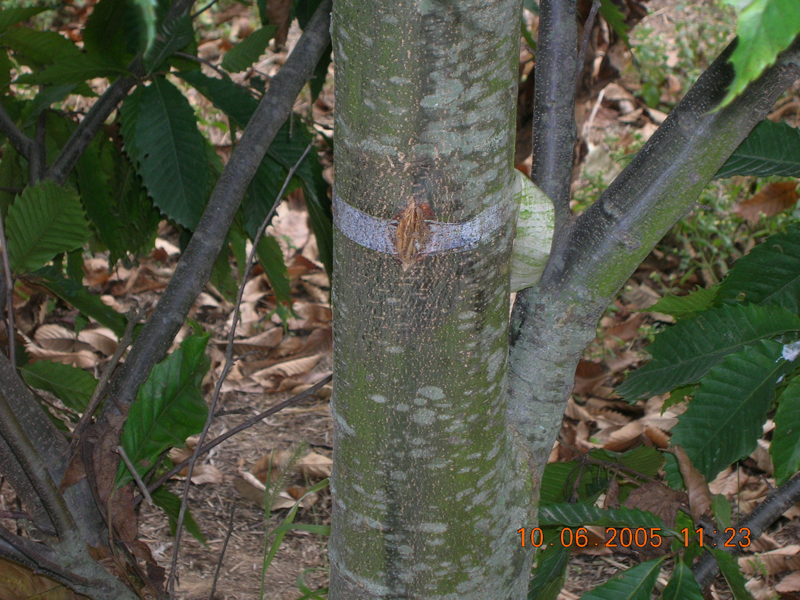

Slide 42
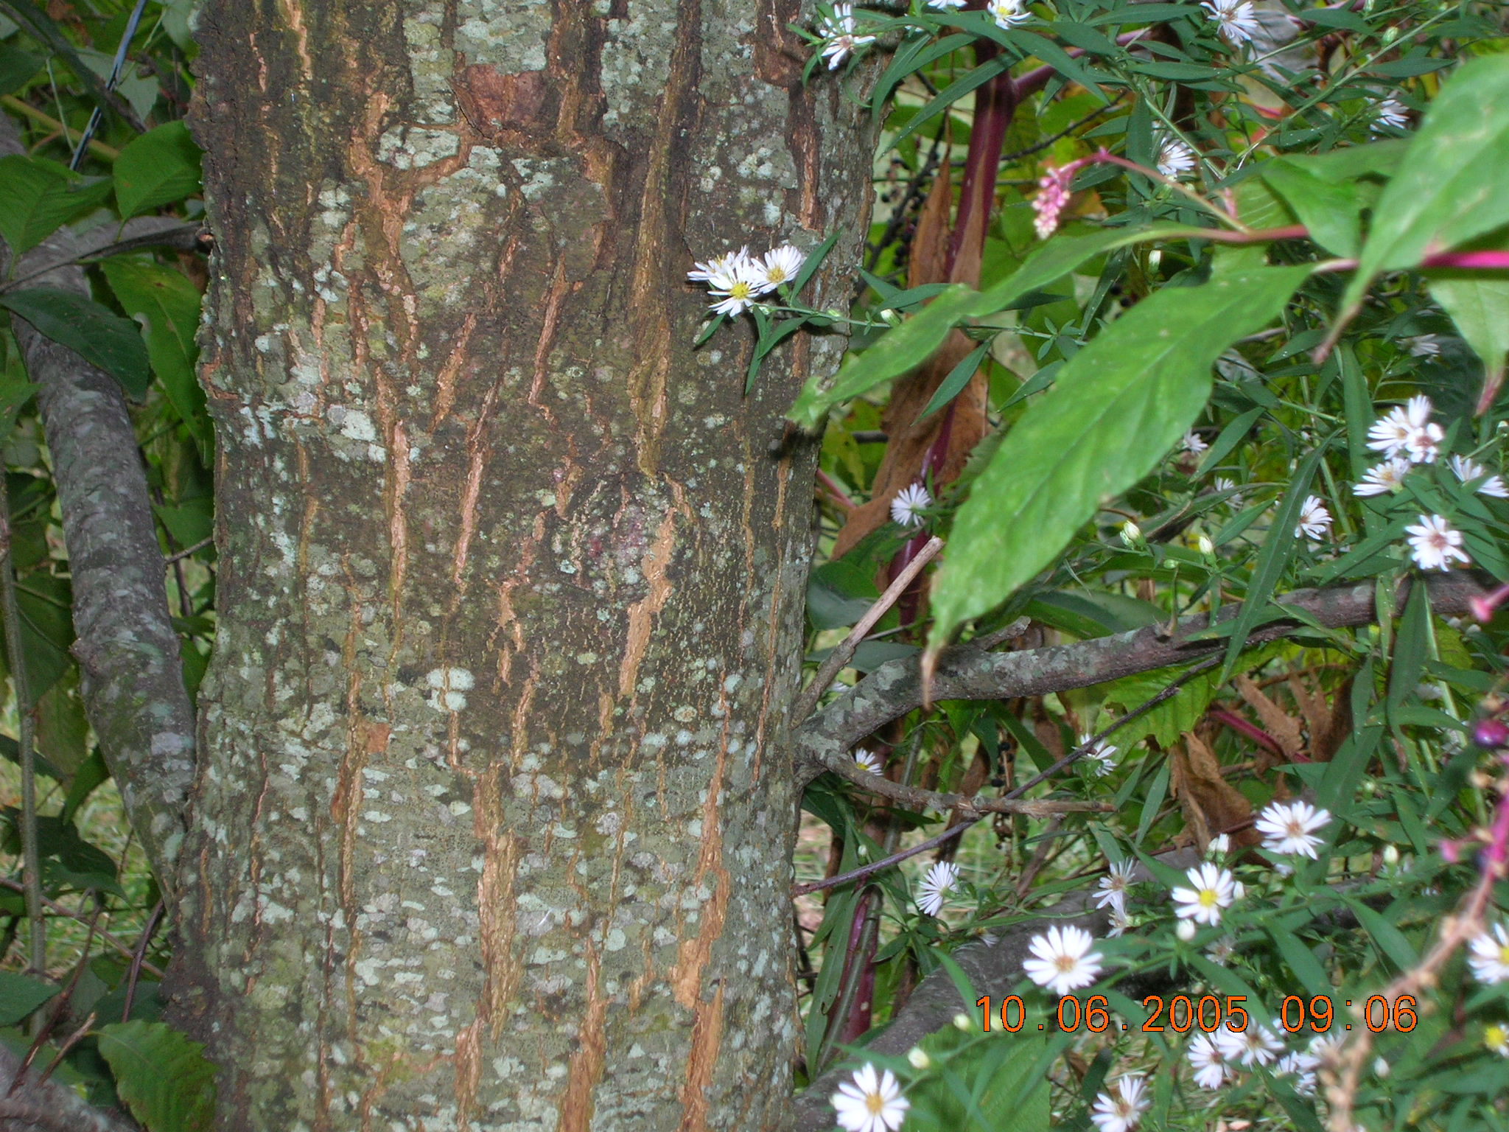

Slide 43
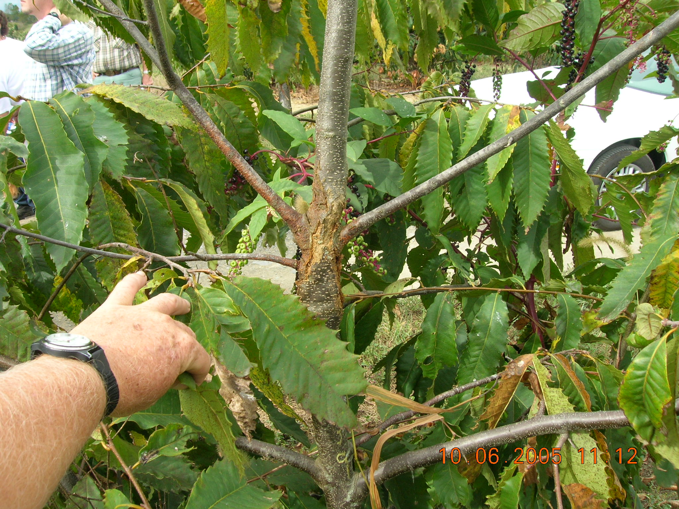

Slide 44
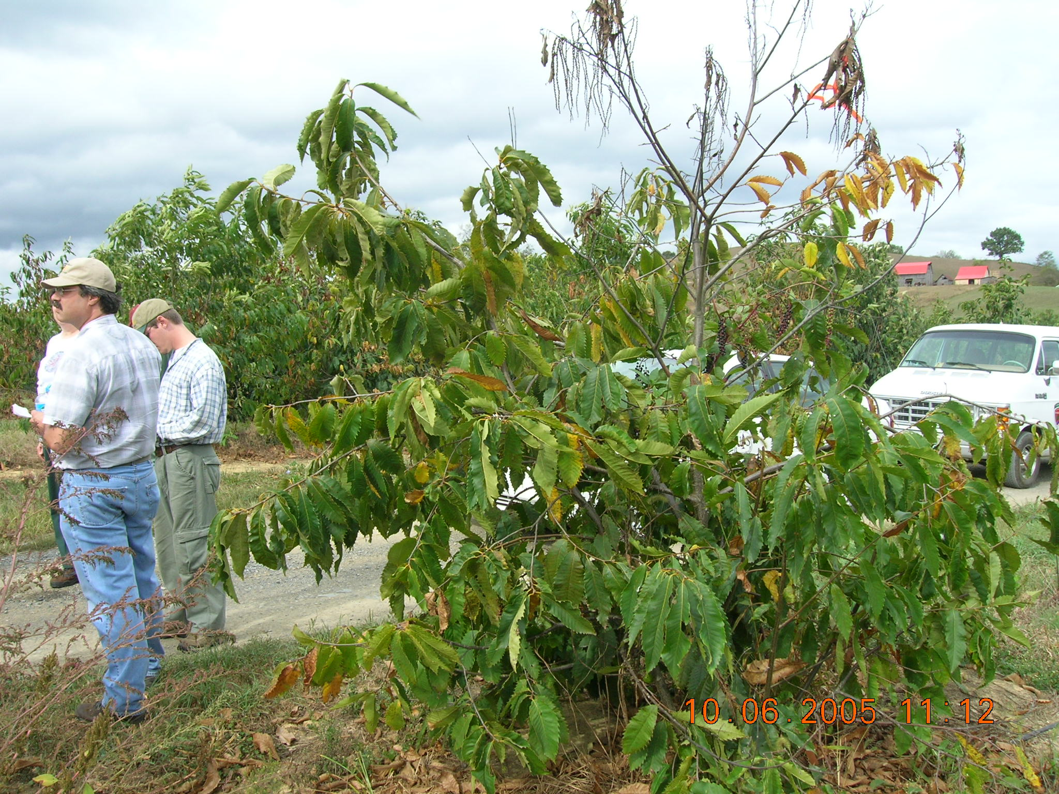

Slide 45
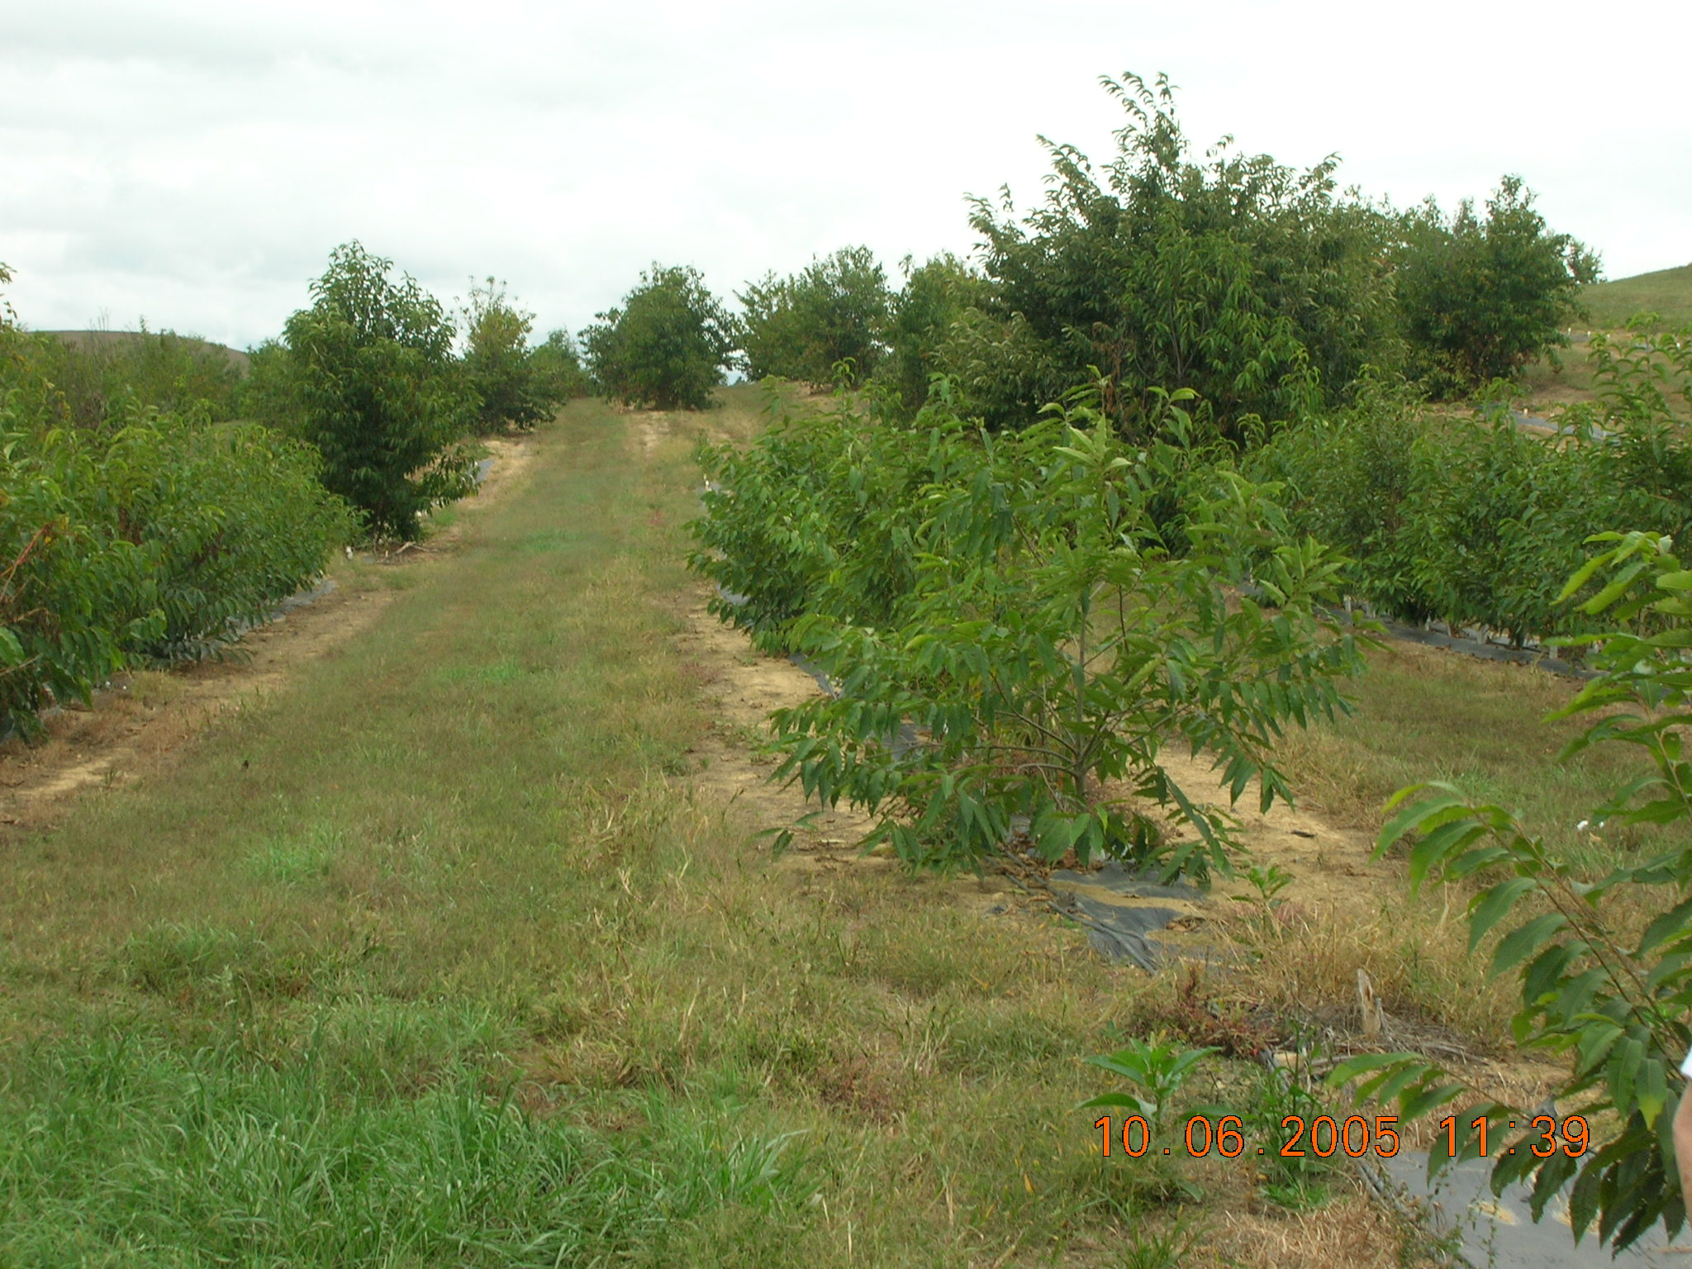

Slide 46
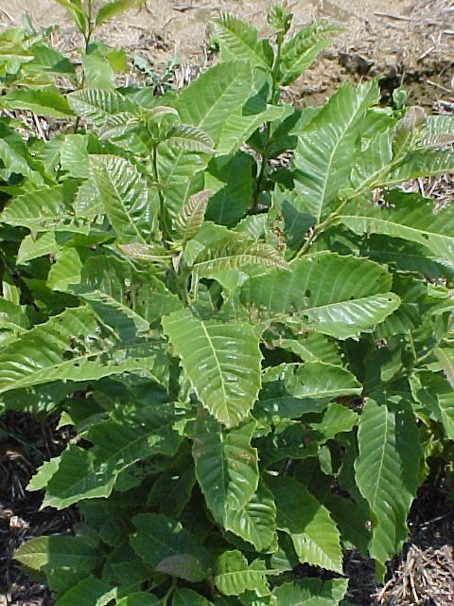
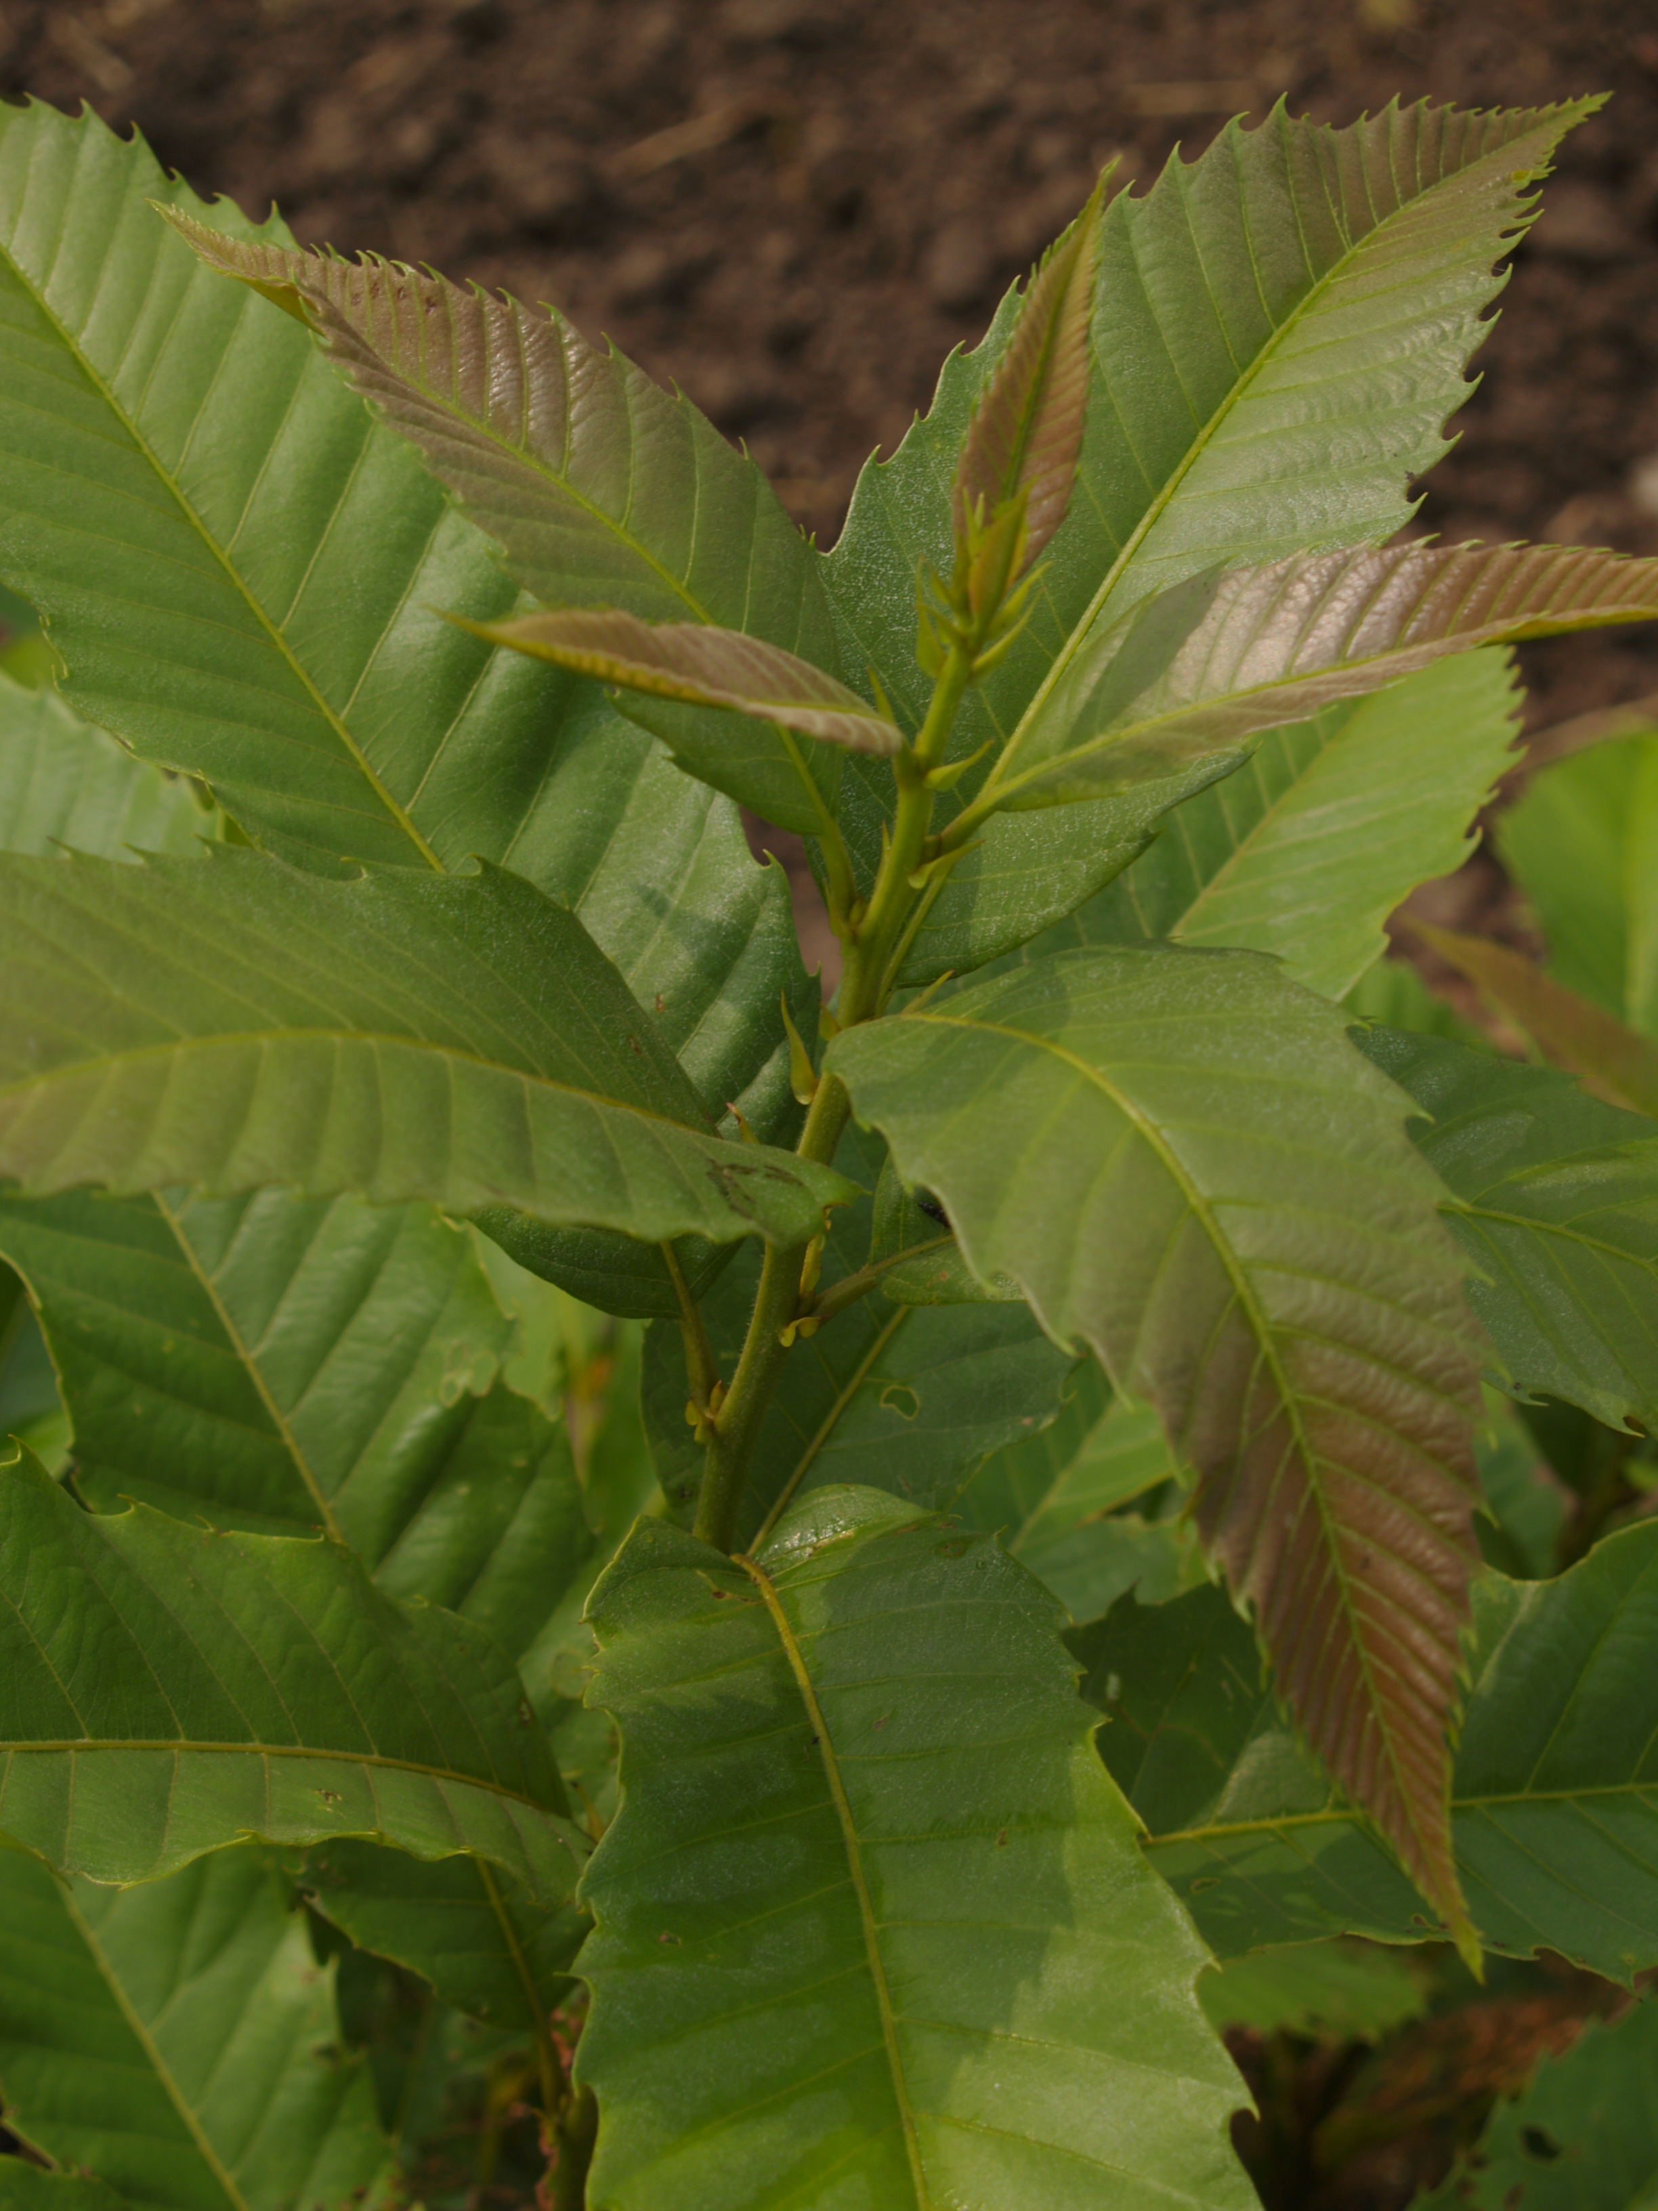
Years Ago Today

Slide 47
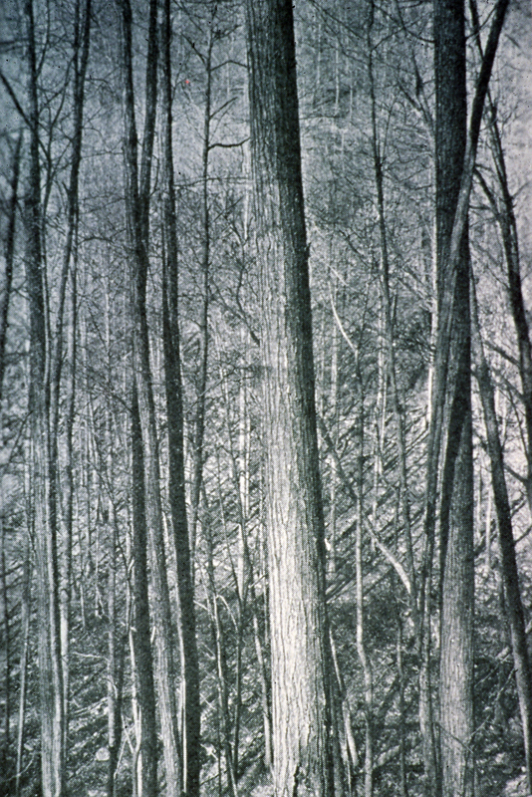
High-quality, straight-grain tree

Slide 48
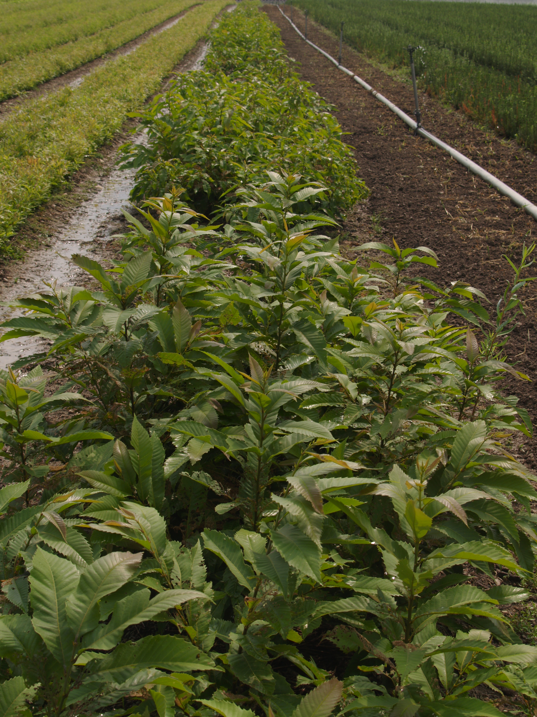
THANK YOU
Tom Dierauf
Jerre Creighton
John Scrivani
Wayne Bowman Billy Apperson
and everyone who helped in the last 40 years.

