Slide 1
Basic Tree Identification
Presented by
Virginia Department of Forestry

Slide 2
What is a tree?
Woody plant
Usually one main stem
Exceeds 15 feet in height and 3 inches in diameter at maturity

Slide 3
Tree Identification Features
Leaves
Bark
Twigs
Reproductive Parts
Overall Form
Growing Site

Slide 4
Leaf Characteristics
Deciduous or evergreen?
Arrangement on stem
Simple or compound?
Pinnate or palmate leaflets or veins
Margins
Base and tip features
Special characteristics (smell, texture, stipules, glands, etc.)

Slide 5
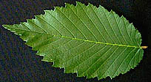
Leaf Parts
Veins (pinnate)
Blade
Petiole
Edge/Margin

Slide 6
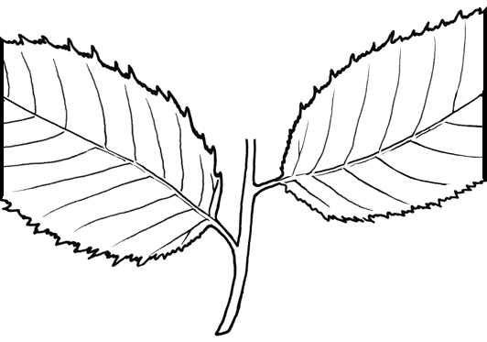
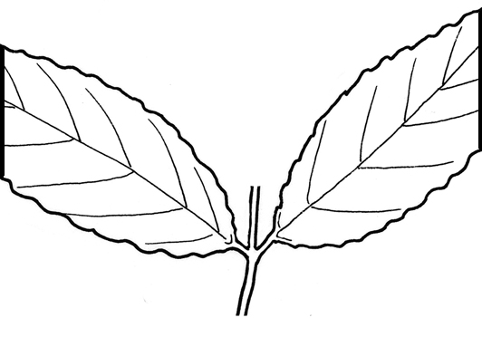
Leaf Arrangement
Alternate
Opposite

Slide 7
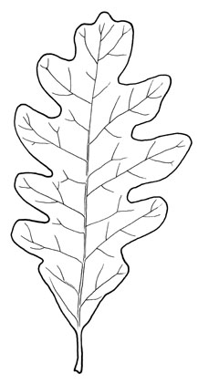
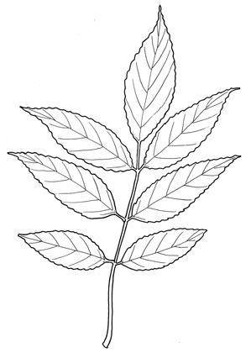
Simple vs. Compound
Simple – leaf has one part
Compound – one leaf has
multiple parts (leaflets)

Slide 8
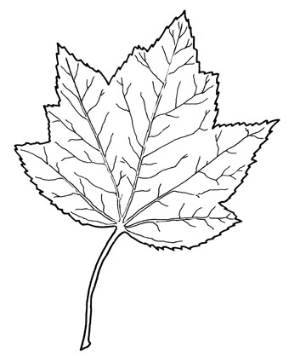
Venation
Pinnate – One main vein starting at the petiole, with
smaller ones branching off
Palmate – Several main veins
starting at the petiole, with
smaller ones branching off

Slide 9
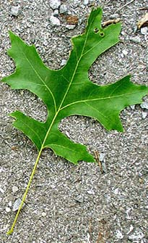
Lobes
Lobe
Sinus

Slide 10
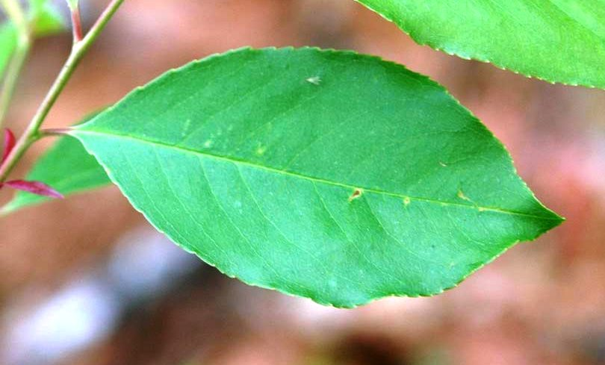
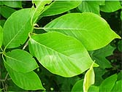
Edges or Margins
Serrated
Entire
Doubly Serrated

Slide 11
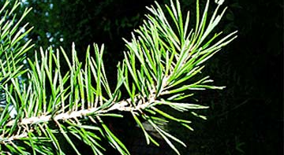
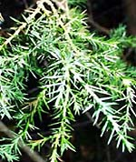
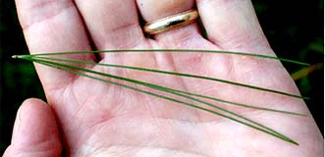
Needles

Slide 12
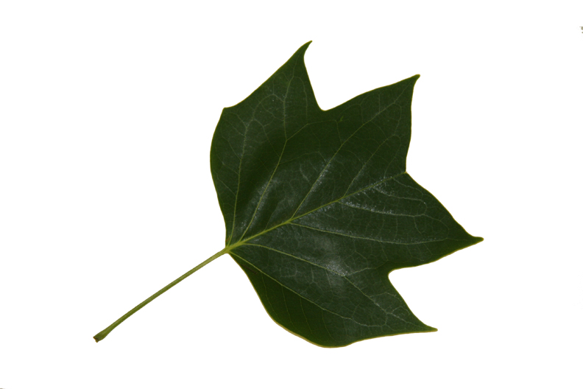
What characteristics do you see?

Slide 13
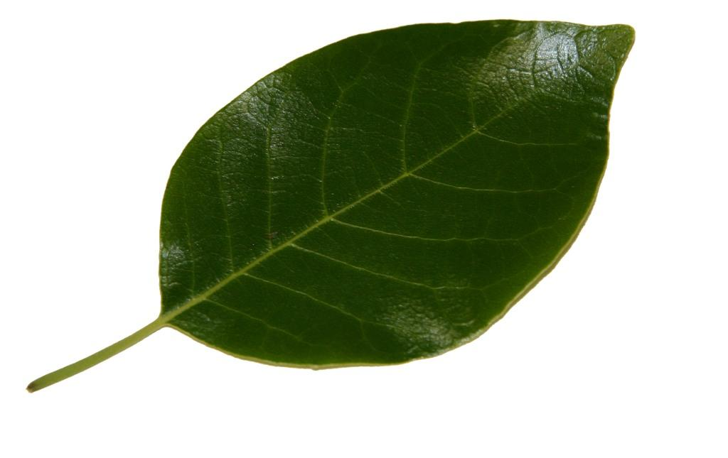
Characteristics?

Slide 14
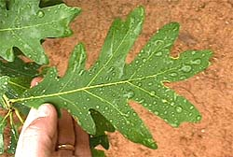
Characteristics?

Slide 15
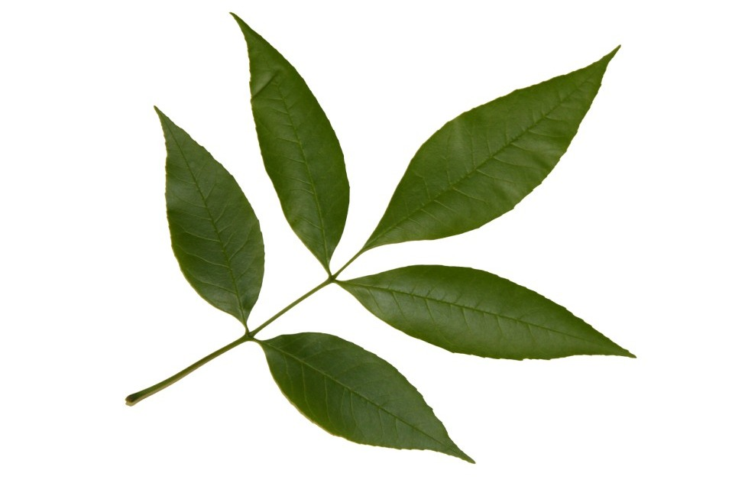
Characteristics?

Slide 16
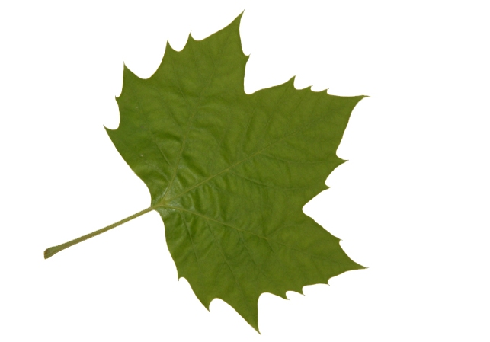
Characteristics?

Slide 17
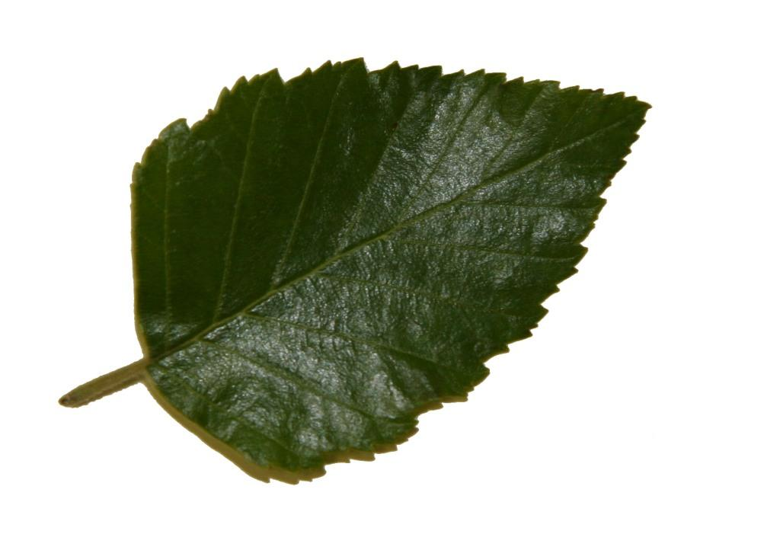
Characteristics?

Slide 18
Bark Characteristics
Terminology is somewhat subjective.
Descriptive terms may include smooth, scaly, ridged, furrowed, fissured, platy, blocky, netted, and more!

Slide 19
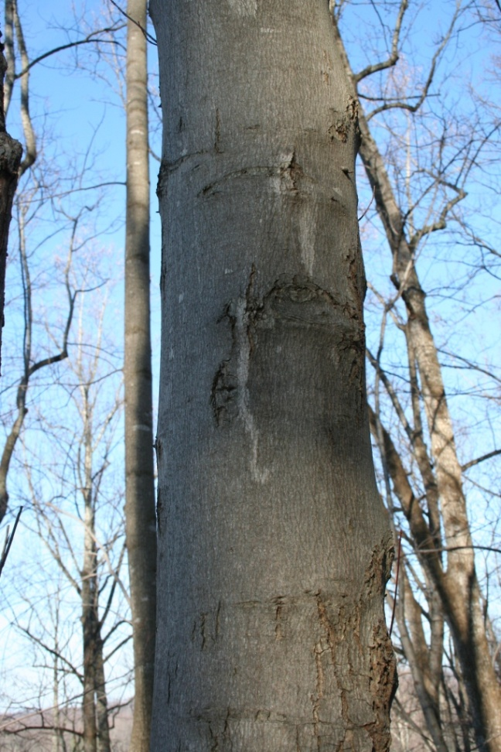
Characteristics?

Slide 20
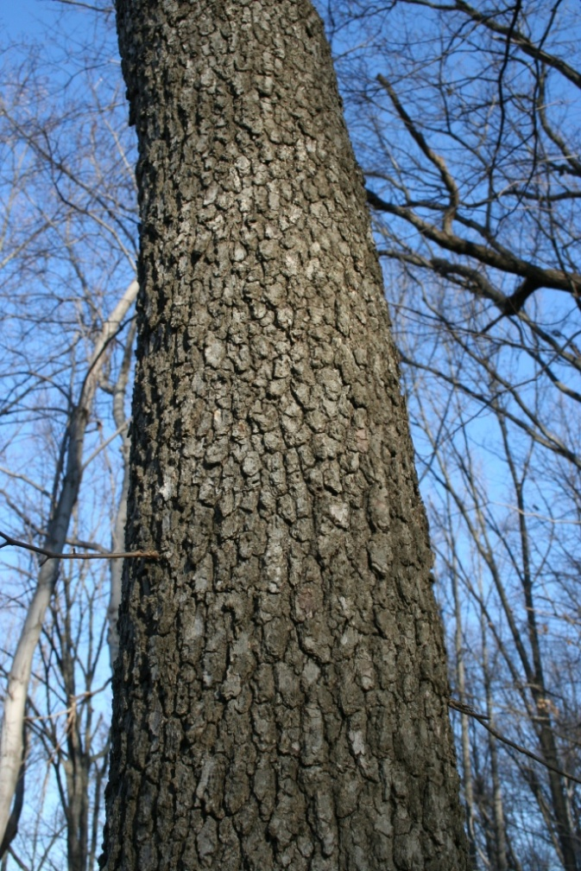
Characteristics?

Slide 21
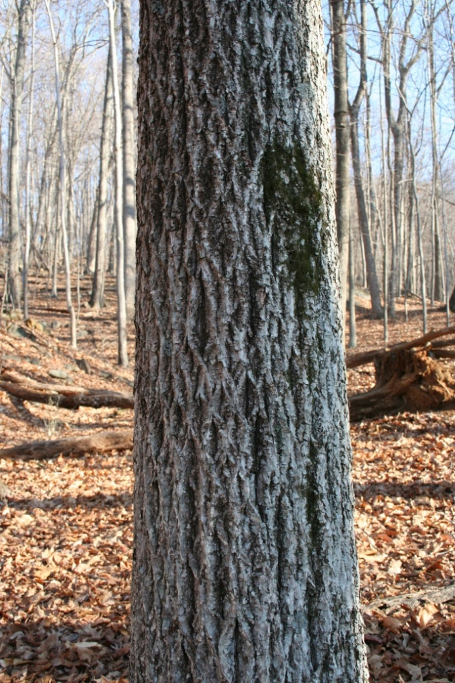
Characteristics?

Slide 22
Twig Characteristics
Leaf scar, w/ bundle scars
Lenticels (the tiny dots)
Pith
Terminal bud
Lateral bud

Slide 23
Tools to Aid in Identification
Your senses – sight, touch, smell
Dichotomous keys and field guides
Hand lens – because details matter!
Optional – sharp knife or clippers

Slide 24
Practice
Practice
Practice!

