Slide 3
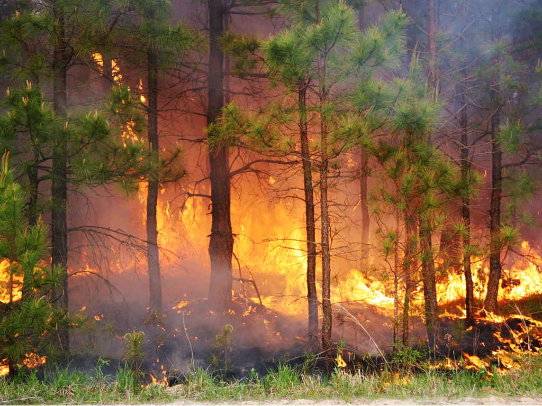

Slide 4
Timber Management
Wildlife Management
Soil & Water Conservation
Recreation
Aesthetics

Slide 5
Protect Forest Resource
Improve Forest Resources
Renew Forest Resources
Conserve Forest Land Base
Protect Water Quality
VDOF Areas of Focus

