Slide 1
As research is being becoming available, findings reinforce what much of the forest community already knows —
trees have a positive impact
on human health

Slide 2
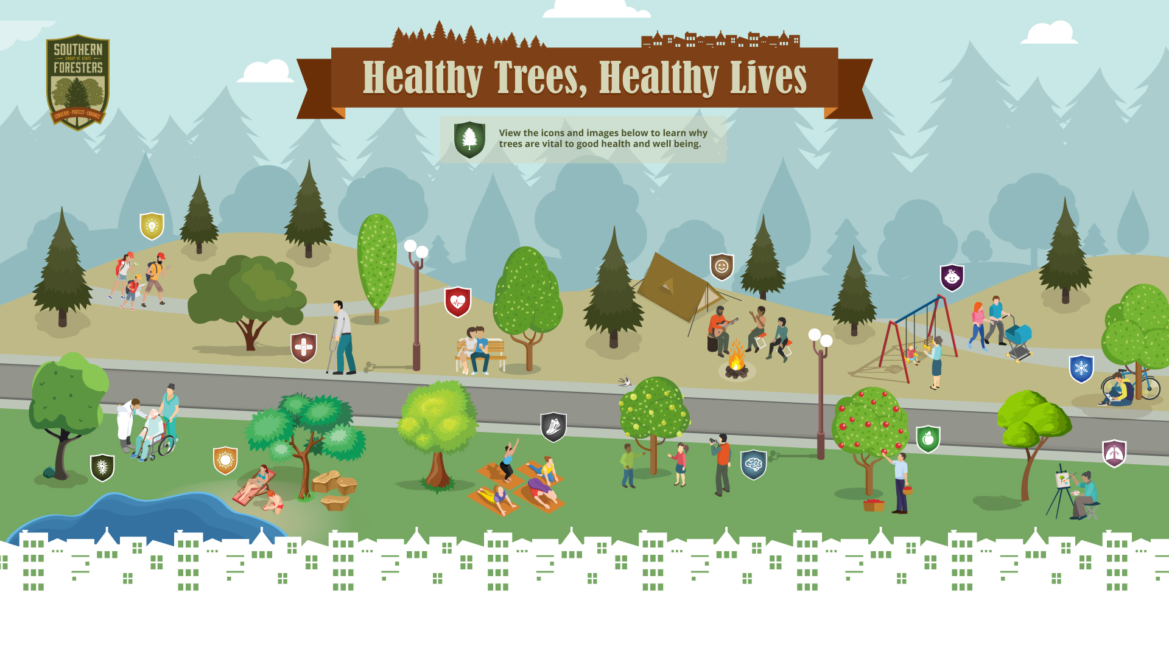
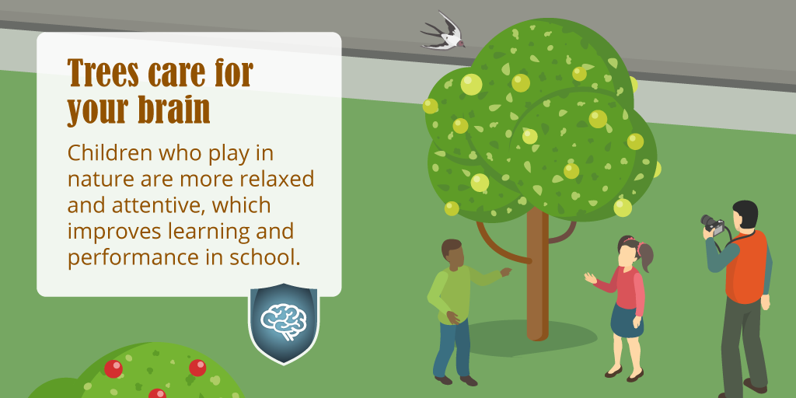
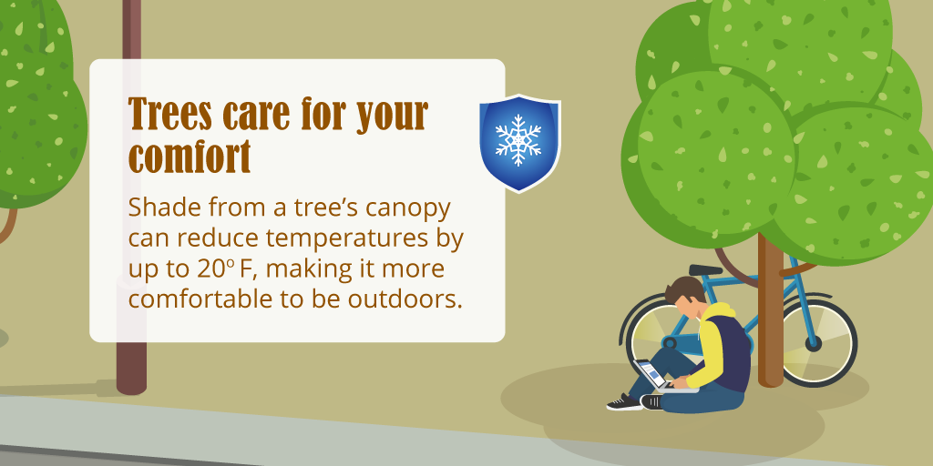
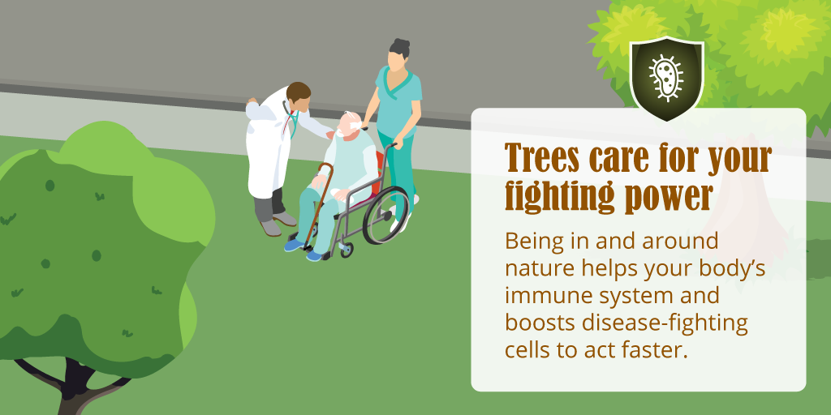
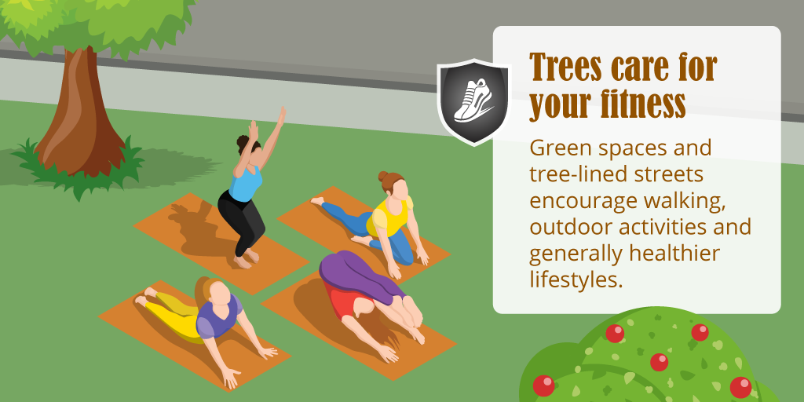

Slide 6
Green spaces and tree-lined streets encourage walking, outdoor activities and generally healthier lifestyles.

Slide 7
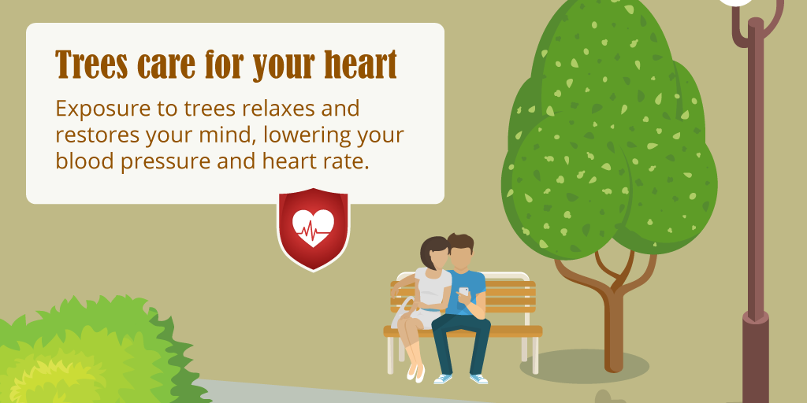
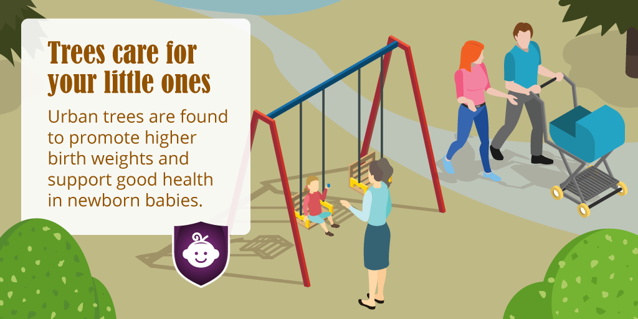
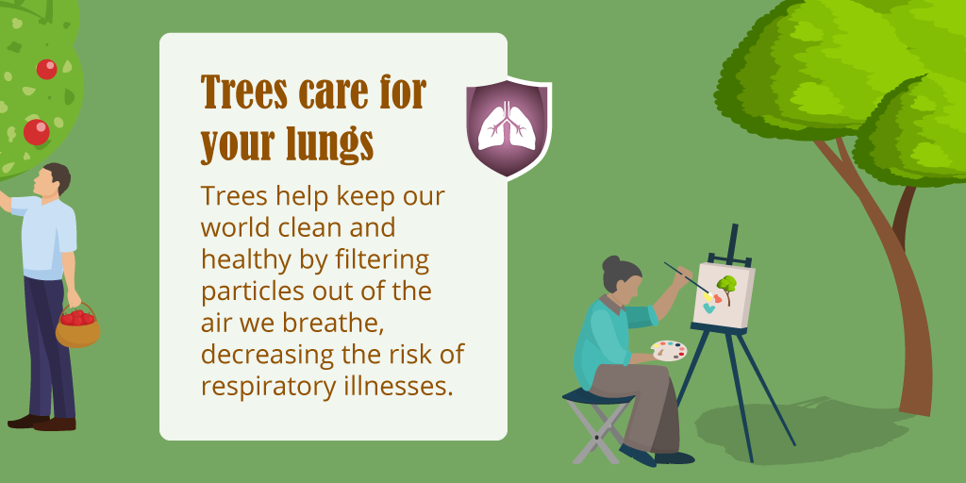

Slide 8
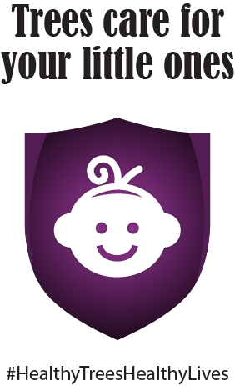
Urban trees promote higher birth weights and support good health in newborn babies

Slide 10
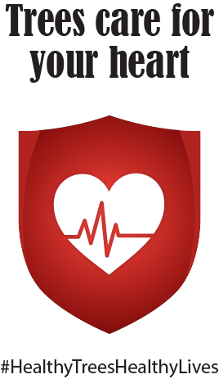
Exposure to trees relaxes and restores your mind, lowering your blood pressure and heart rate.

Slide 12
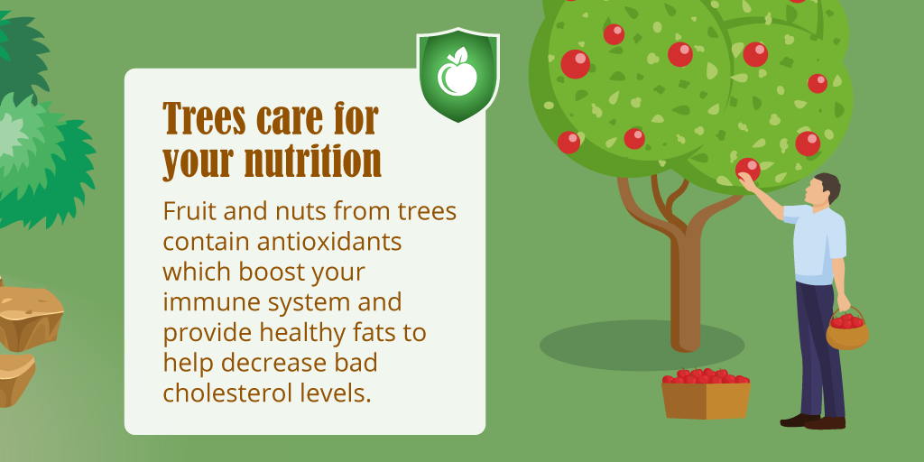
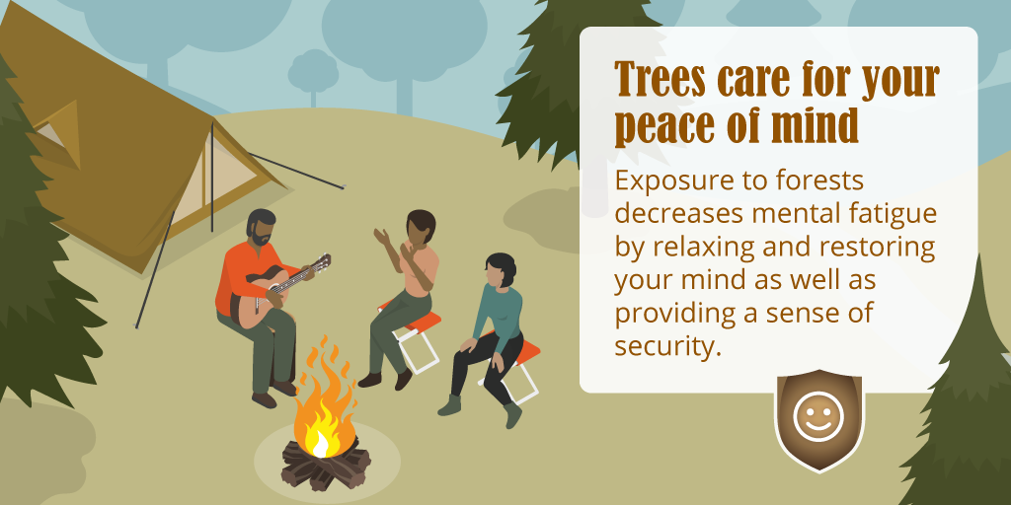
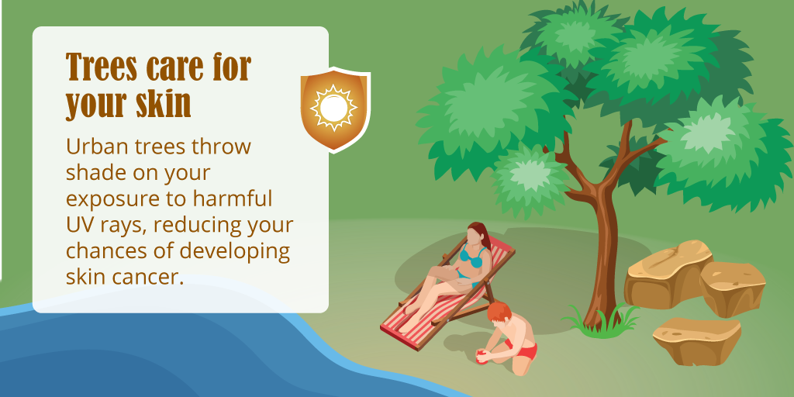
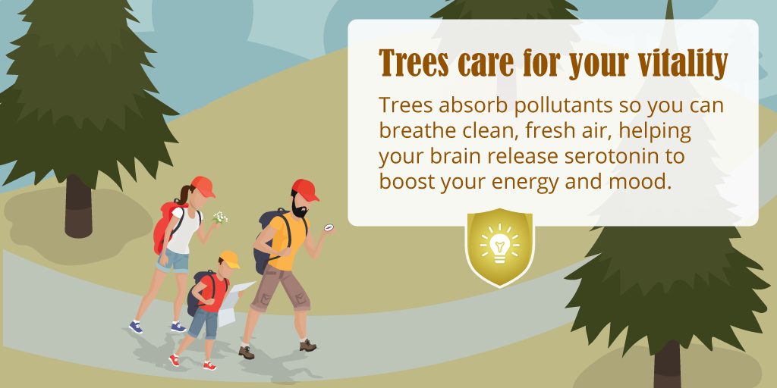

Slide 14
Trees absorb pollutants so you can breathe clean, fresh air, helping your brain release serotonin to boost your energy and mood.

Slide 15
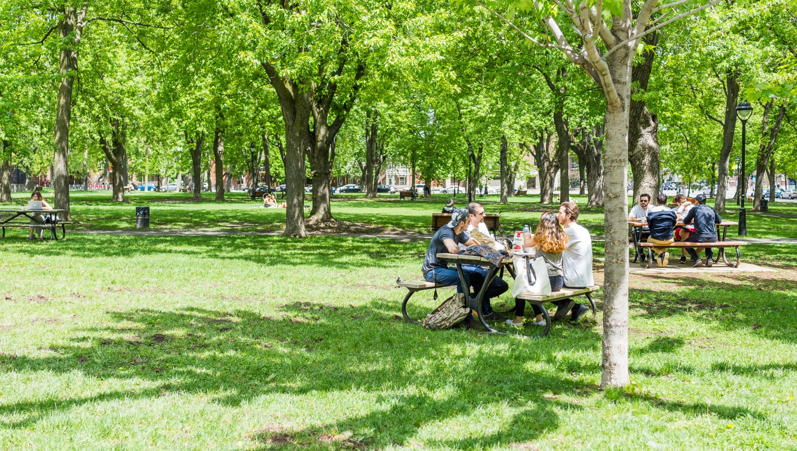
Shade from a tree’s canopy can reduce temperatures by up to 20º F, making it safer and more comfortable to be outdoors.

Slide 17
#HealthyTreesHealthyLives
We’re looking for life’s little moments of Healthy Trees, Healthy Lives
Tag yours on social media

Slide 18
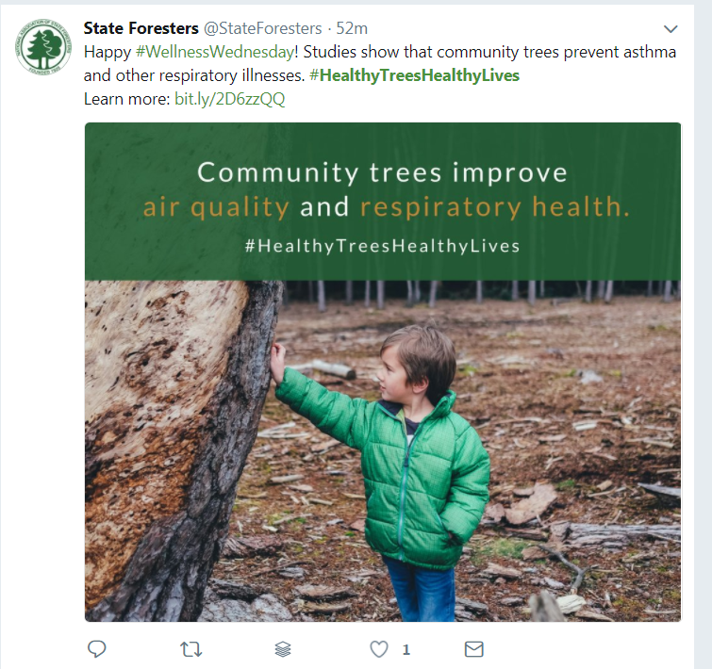
#HealthyTreesHealthyLives https://www.youtube.com/watch?v=02wSvWakDyI

Slide 19
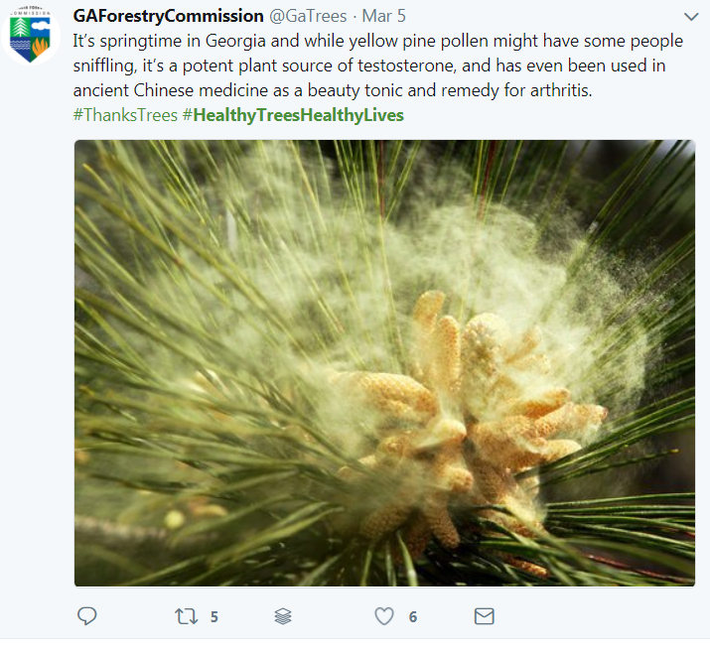

Slide 20
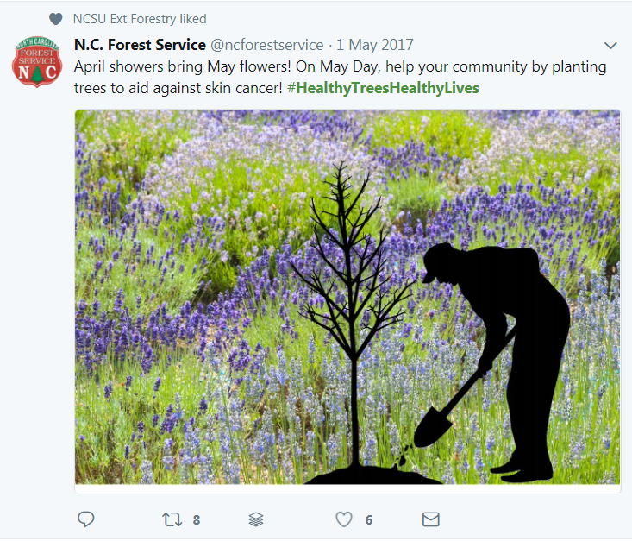

Slide 21
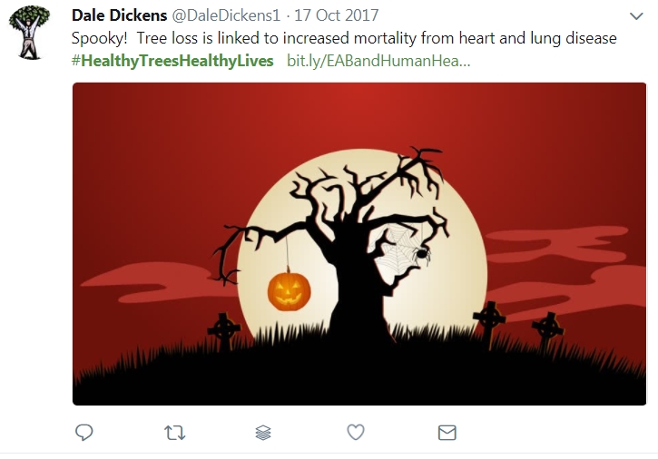

Slide 23
http://www.southernforests.org/urban/healthy-trees-healthy-lives/
Explore how urban forests can improve our physical and mental health and promote healing.

