Slide 1
Northern Long-Eared Bat
Preliminary Information from DOF and DWR
based on USFWS Guidance

Slide 2
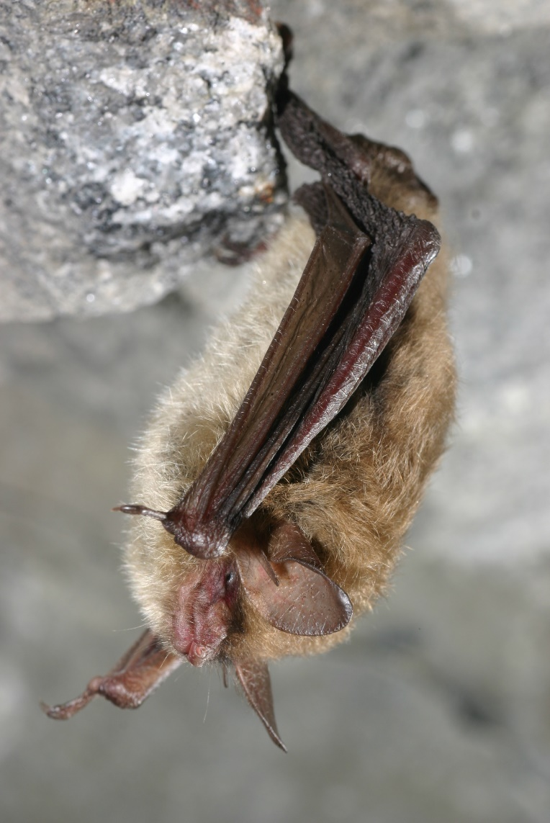
Northern Long-Eared Bat (NLEB)
NLEB listed as federally endangered by the U.S. Fish and Wildlife Service as of March 31, 2023
Photo credit: U.S. Fish and Wildlife Service, Al Hicks, NYDEC
Northern long-eared bat, Myotis septentrionalis

Slide 3
My Goals for Today
Increase awareness of the potential impacts on forestry.
Share U.S. Fish and Wildlife (USFWS) guidance.
Share what the Virginia Department of Wildlife Resources and DOF are creating for forestry and other projects.
Get feedback/questions for information to follow.

Slide 4
Background
NLEBs overwinter mostly in caves and spend summers in forests.
Southeast Virginia has a year-round population.
Populations are collapsing due to fungus in caves.
NLEBs were listed as Threatened in 2015.
Listed as Endangered on March 31, 2023.
Endangered classification escalates protection and no longer allows incidental take in relation to forestry.

Slide 5
Federal Guidance
USFWS issued guidance for federal and non-federal projects.
The non-federal project guidance is labeled “interim voluntary.”
Interim means for a year, they may revise guidance for after March 31, 2024.
Voluntary means you can choose to protect yourself from potentially violating the Endangered Species Act or not.

Slide 6
DWR and DOF Providing Info
Working on a simple flowchart to assist with forestry projects.
What counts as forestry projects?
Does the project have a Federal Nexus? Yes/No – Next Steps
Is the project located in an identified NLEB site? Yes/No – Next Steps

Slide 7
What counts as forestry projects?
Forestry means timber management, including:
Thinning
Clearcutting
Creation of forest openings
Prescribed fire
Activities associated with treatment of non-native invasive species
(Bats utilize trees as small as 3 in. DBH)

Slide 8
Does the project have a Federal Nexus?
Forestry activities conducted on federally-managed land.
Removing trees to clear for development that requires permitting.
Forestry activities funded with federal cost-share.
If YES, this presentation DOES NOT refer to these projects. Federal projects have requirements.

Slide 9
Is the project located in an identified NLEB site?
A. Roost Tree
Use NLEB Winter Habitat and Roost Trees map.
B. Capture Site
C. Hibernacula
(West of I-81)
D. Year-Round Habitat
(Southampton, Sussex, Surry, Isle of Wight, Suffolk, Chesapeake, VA Beach)
If NO, it is assumed that bats are not likely found in your project location and no other steps are recommended.

Slide 10
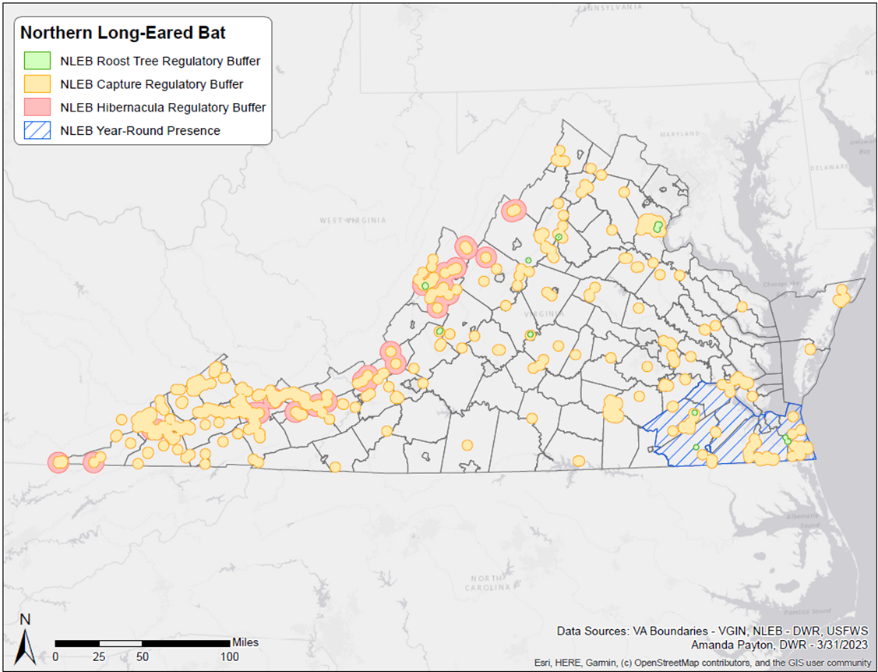

Slide 11
Is the project located in an identified NLEB site?
If YES, avoid activities during restricted times of year OR have a survey conducted to see if bats are present.
NLEB Surveys
List of contractors is available.
Survey period is March 1 – November 15.
Acoustic surveys must be conducted over 14 detector nights with suitable weather for every 123 acres of project.
Mist-netting requires slightly fewer nights but requires the surveyor to have appropriate federal and state permits for the capture of listed bats.
Surveys done to standards are considered conclusive.

Slide 12
Is the project located in an identified NLEB site?
If you cannot determine that bats are not present, then avoid activities during restricted times of year.
A. Roost Tree
Avoid activities between:
April 1 - November 14
B. Capture Site
C. Hibernacula
Avoid activities year-round
Avoid activities between:
December 15 - February 15
April 15 - July 30
D. Year-Round Habitat

Slide 13
DWR Map Application
https://dwr.virginia.gov/wp-content/uploads/media/NLEB-Regulatory-Buffers-2023.pdf
USFWS will provide updates at least twice per year.
No automatic notification system for updates at this time.
Unsure of process for removing a site from the map, but negative surveys are good for 5 years.

Slide 14
Additional Information
Not entirely clear on current, ongoing private forestry activities.
It may be possible to conduct very limited habitat modification during the time-of-year restrictions.
DWR doesn’t believe that getting incidental take permits from USFWS will be a viable option for private forestry.

Slide 15
Resources and Questions
Visit USFWS website for official guidance.
https://www.fws.gov/species/northern-long-eared-bat-myotis-septentrionalis
DWR will share resources on its website.
https://dwr.virginia.gov/wildlife/information/northern-long-eared-bat/
https://dwr.virginia.gov/wildlife/bats/northern-long-eared-bat-application/
DOF will share resources via the DOF website.
www.DOF.Virginia.gov
Send questions to: VDOF@DOF.Virginia.gov

